Slide 1
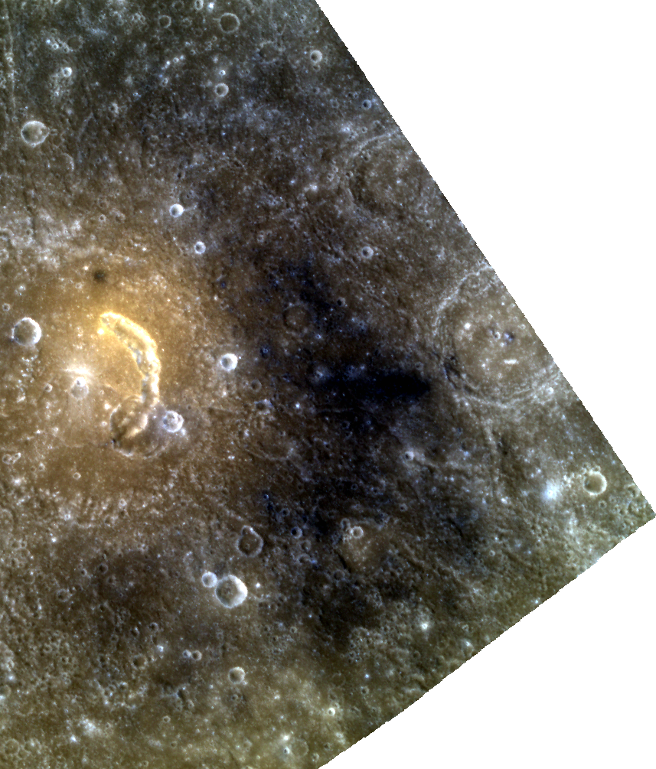

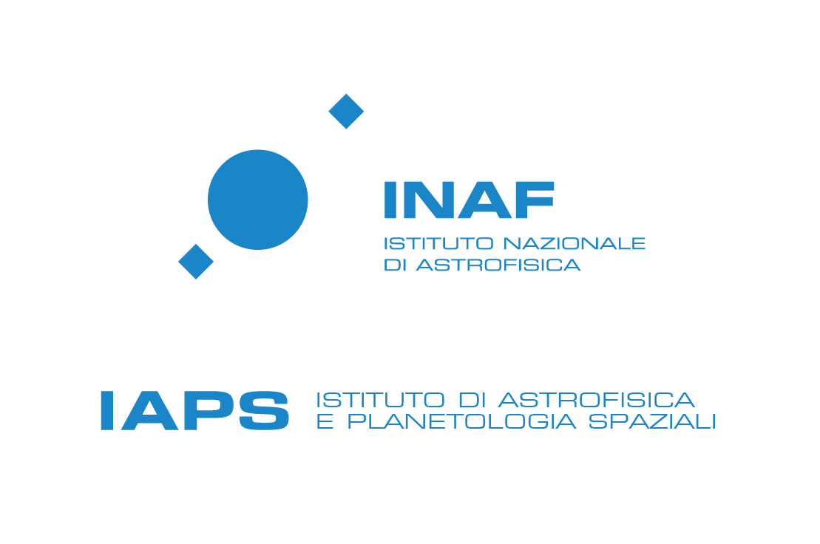
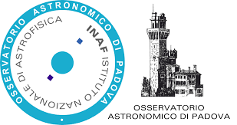



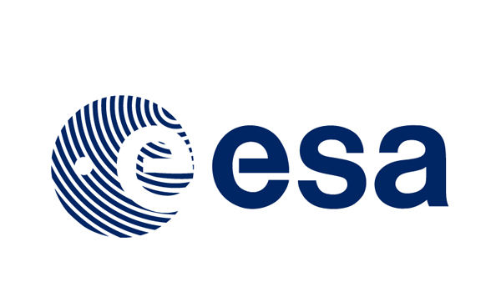




Wide-ranging characterization of explosive volcanism on Mercury: origin, properties, and modifications of pyroclastic deposits
Project ID:552, led by Galiano Anna
https://tools.issibern.ch/
https://teams.issibern.ch/volcanismonmercury/

Slide 2
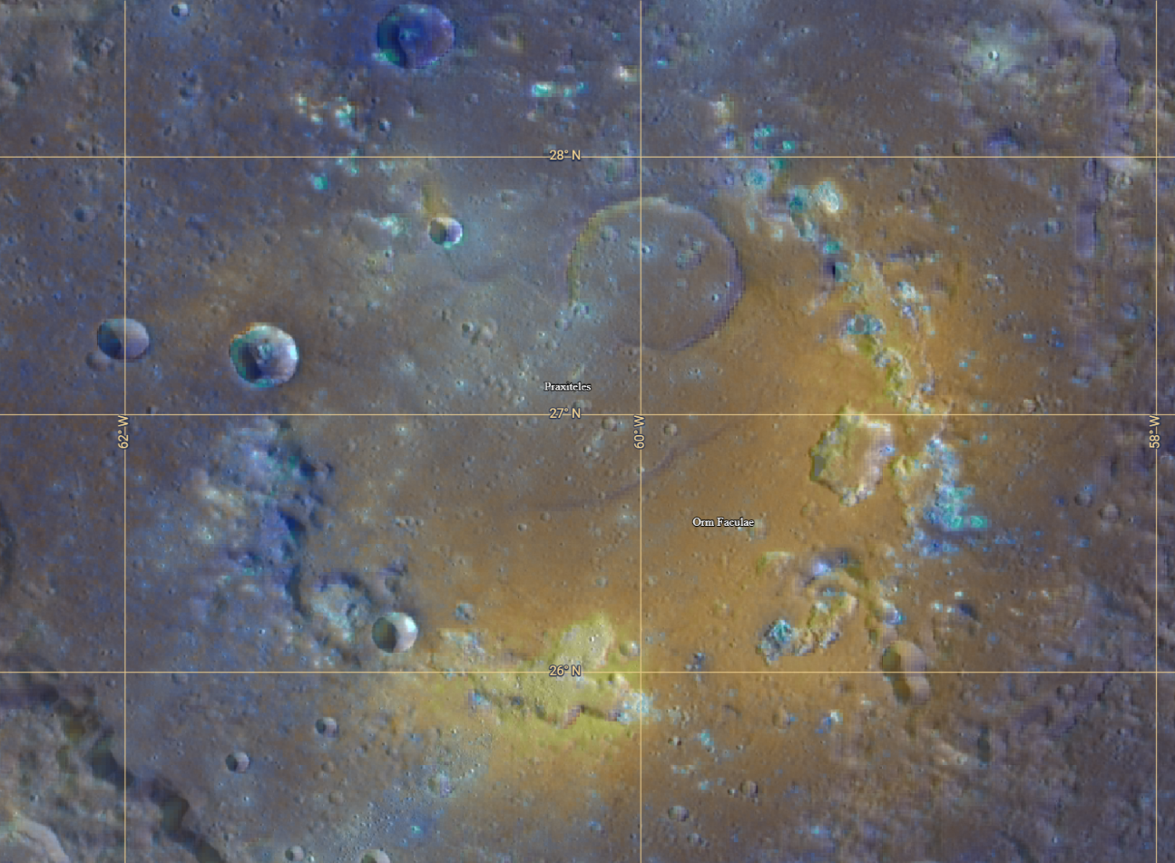
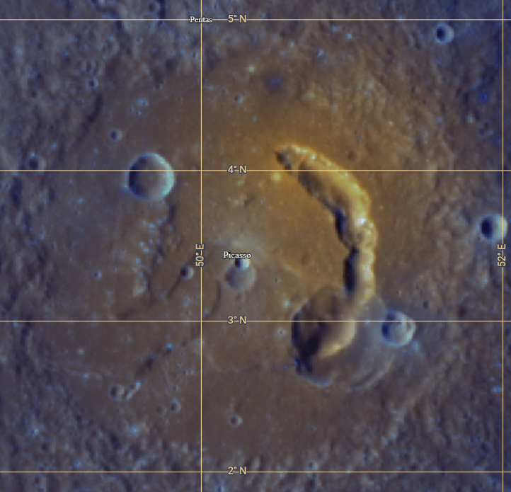
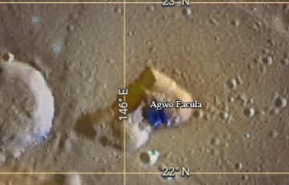
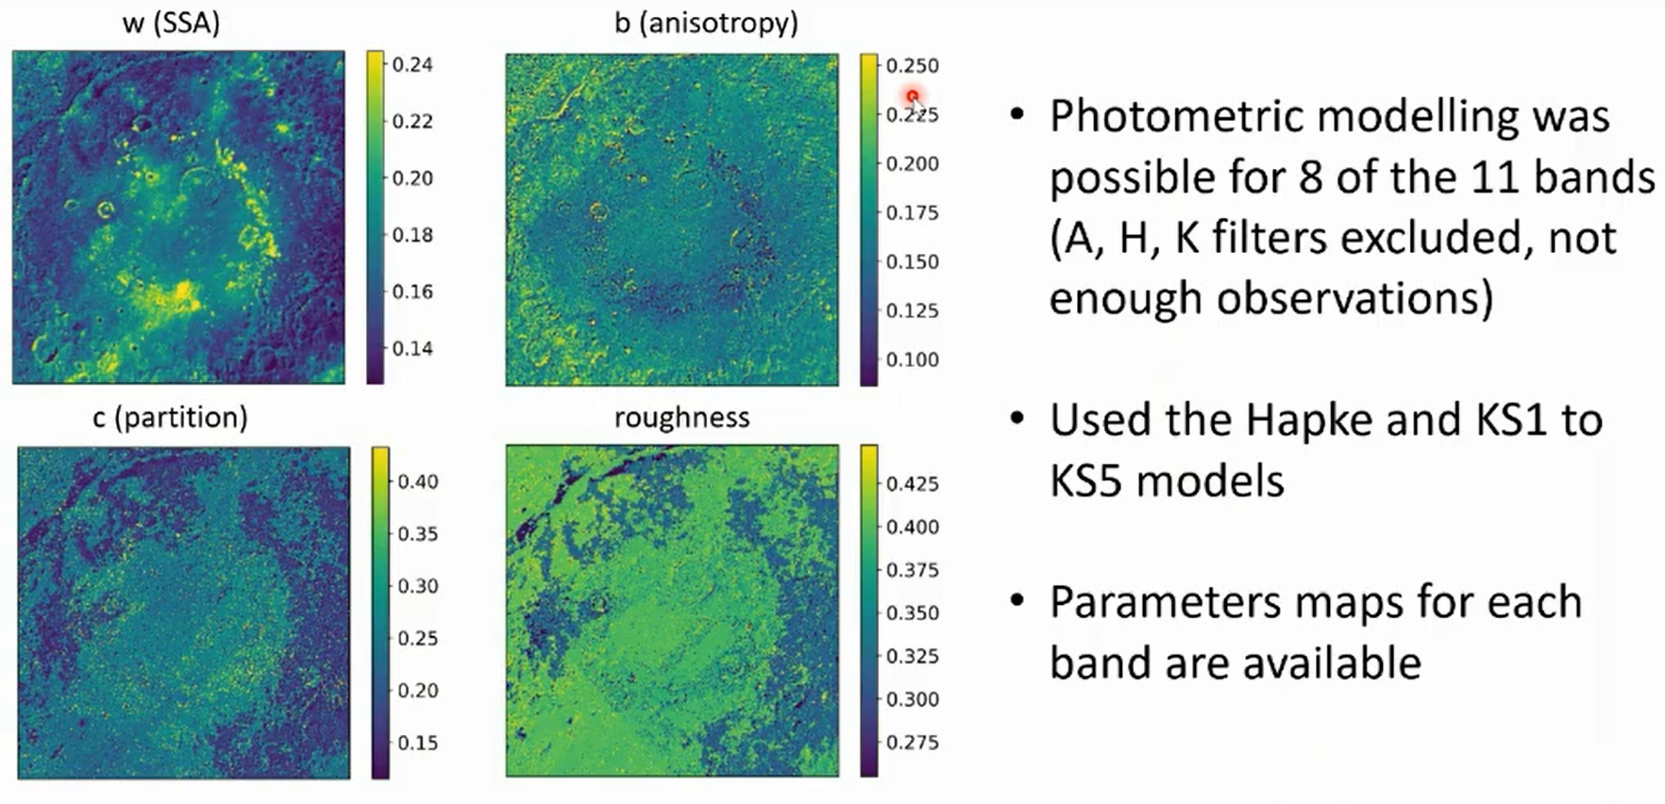
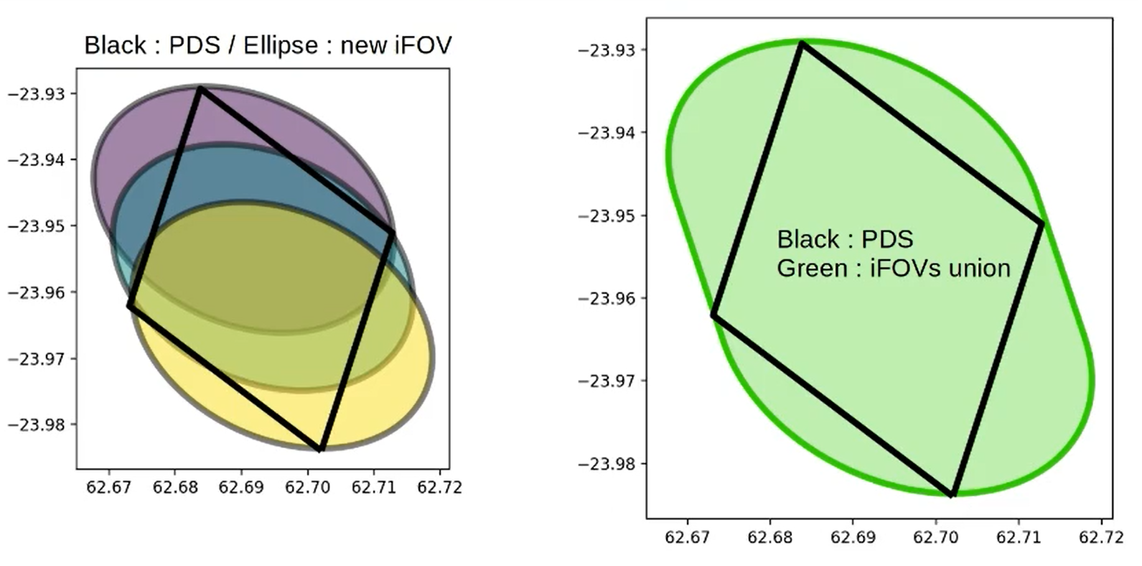
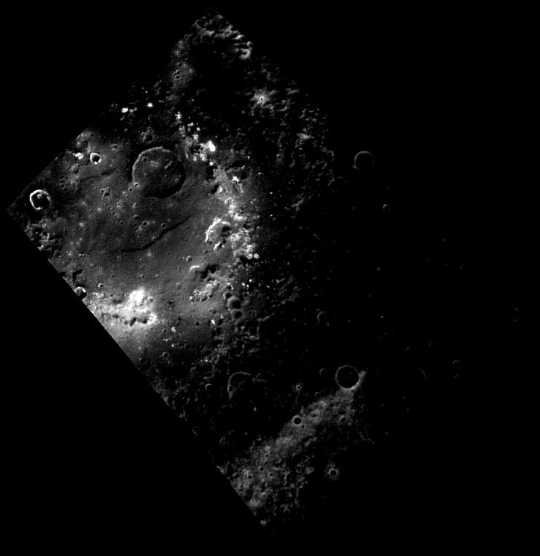
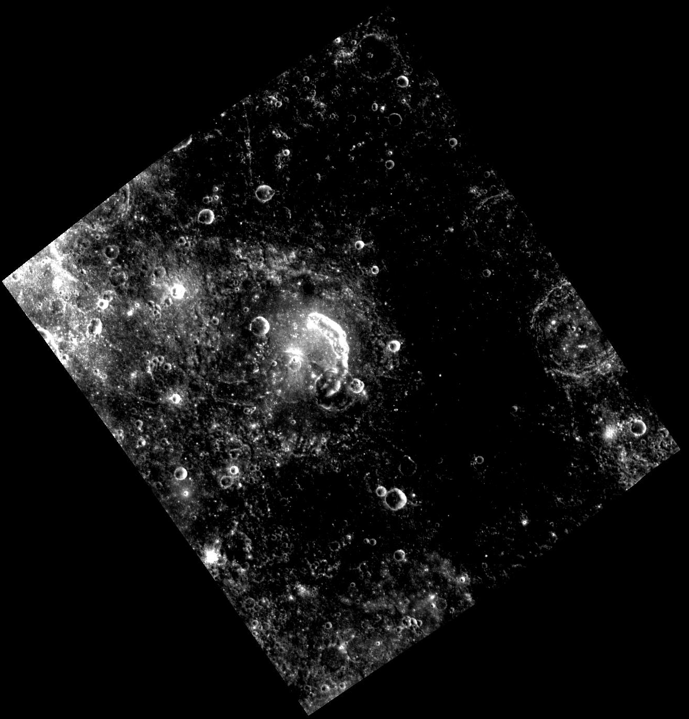
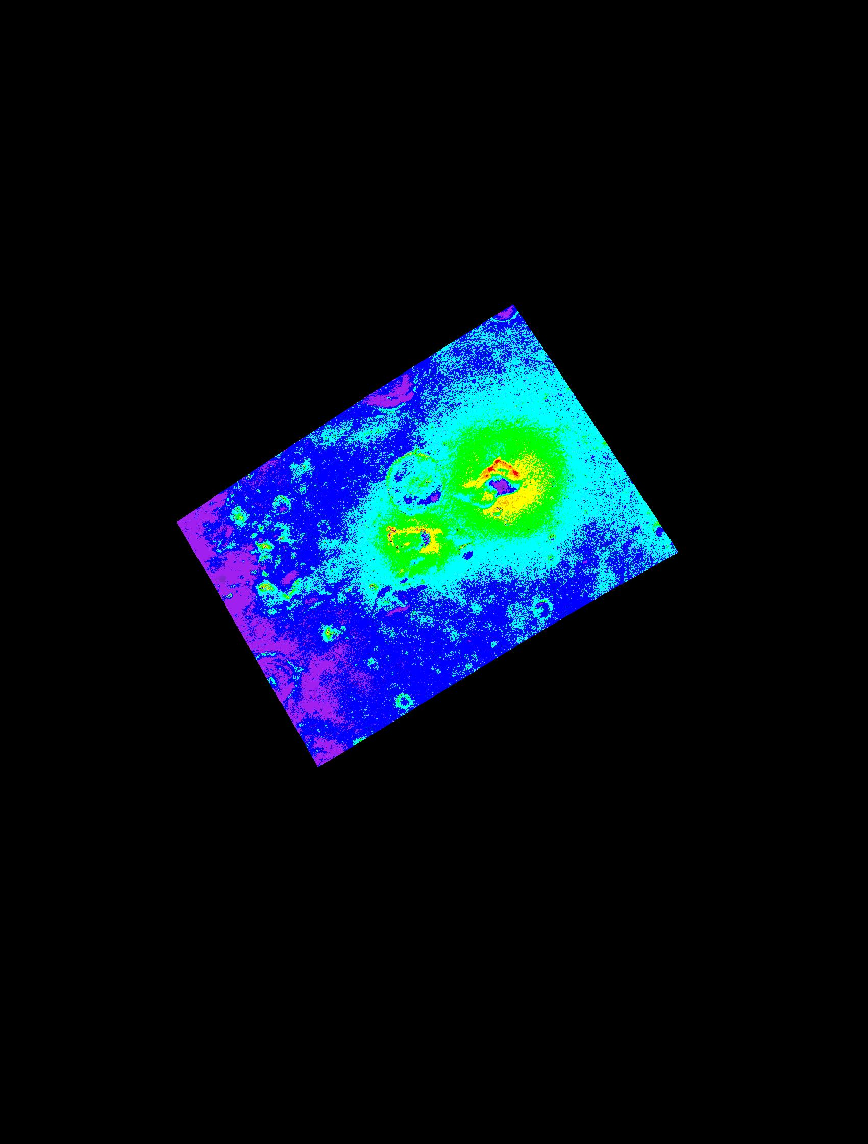
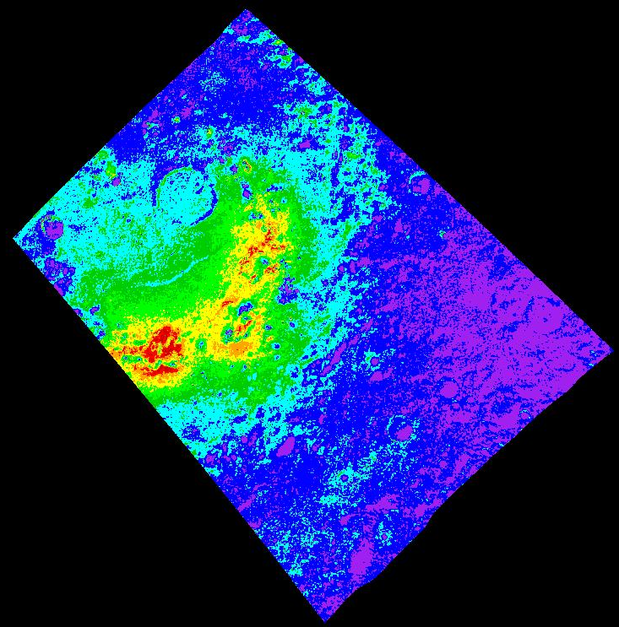
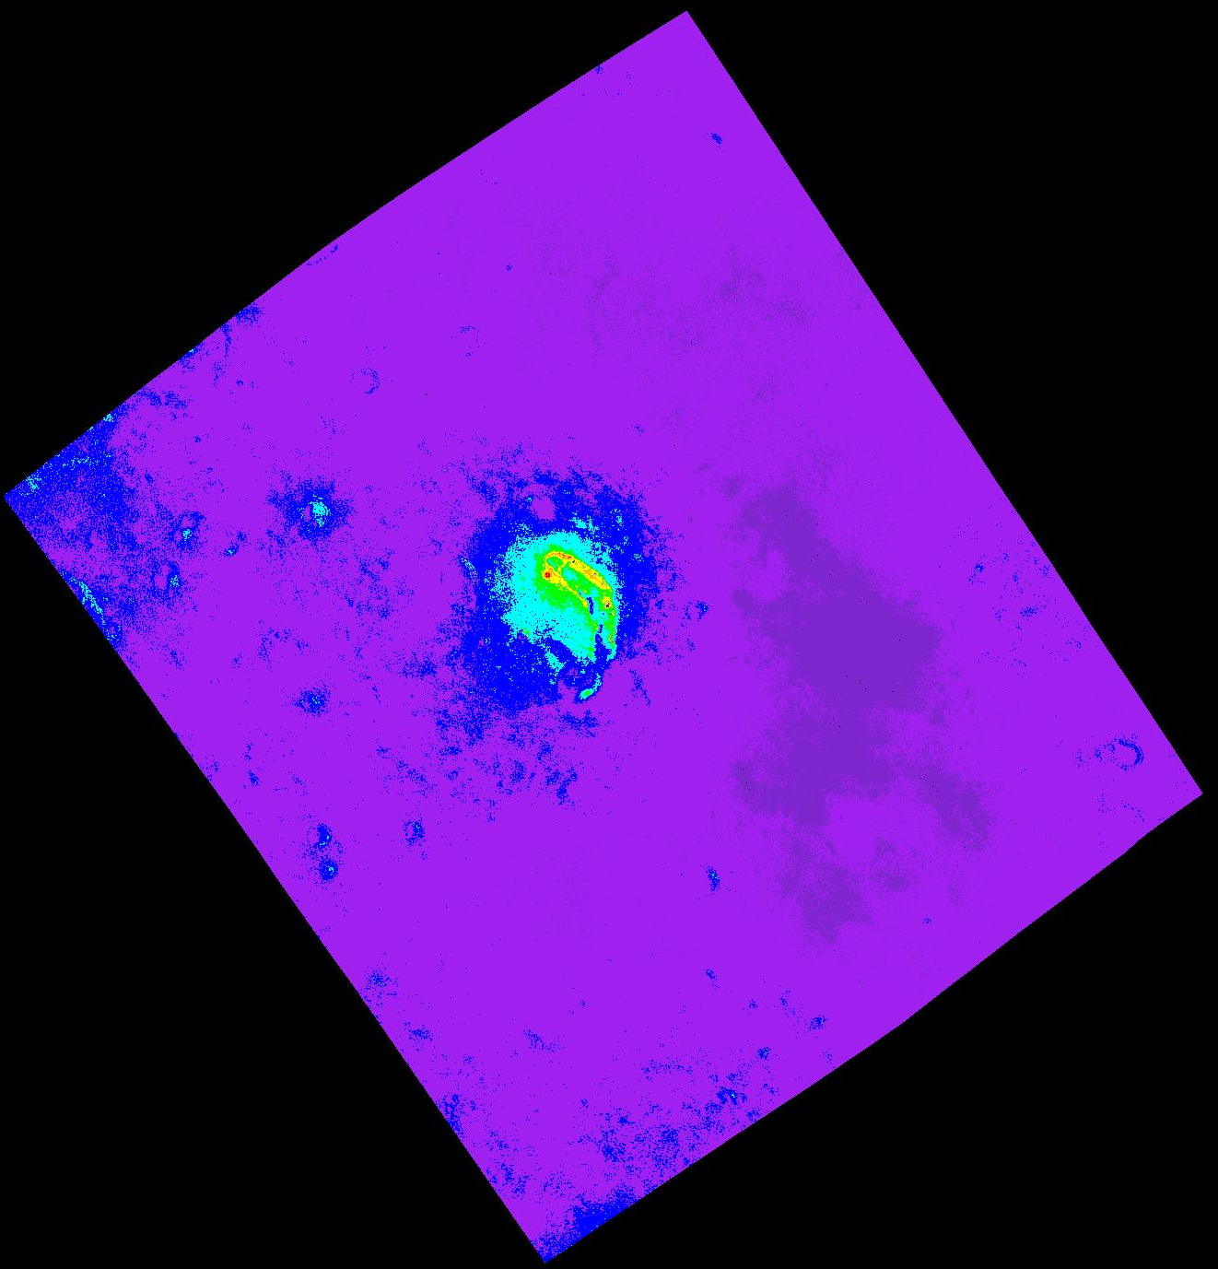
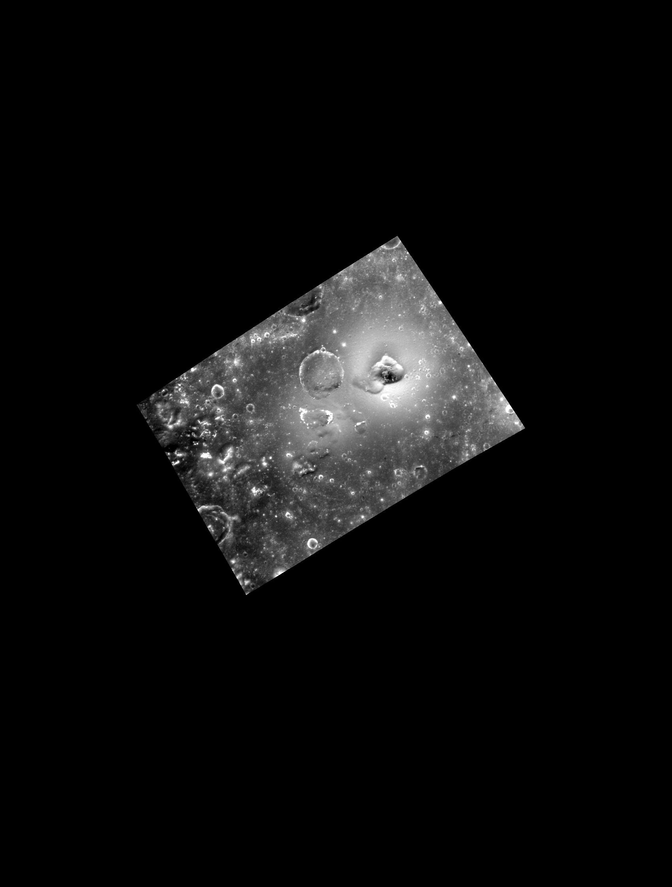



Investigated pyroclastic deposits:
Orm Faculae (27.11°N, 60.28°W)
Serp Facula (3.44°N, 50.24°E)
Agwo Facula (22.40°N, 146.14°E)
Orm Faculae
Serp Facula
Agwo Facula
Photometric correction on MDIS and MASCS data
A photometric correction specifically tailored for pyroclastic deposits was applied to MDIS/WAC cubes to remove the effects of topography from the spectra. Faculae have a higher roughness than the surrounding terrain, as observed for Orm Faculae.
The spectrophotometric analysis on MASCS data (whose footprints were recalculated) suggests that the surface roughness of the vent is not well represented by Hapke global parameters (conversely to Mercury’s surface)
Spectral analysis of the faculae
Orm Faculae
Serp Facula
VIS Slope (µm⁻¹)
VIS Slope (µm⁻¹)
The maps of reflectance and VIS slope, estimated in photometrically corrected MDIS cubes, provide insights about the extent of the faculae and the symmetric/asymmetric distribution of the pyroclastic deposits.
Agwo Facula shows a higher amount of pyroclastic deposits in the eastern side, while Serp Facula in the norther side
Faculae are brighter and redder with respect to the surrounding terrain. The brightness and reddening of the MDIS spectra reduces moving further away from the vent
VIS Slope (µm⁻¹)
0.15
0.15
Orm Faculae NE $\sim 18$ km Radius
0.17
$\sim$23 km Radius
$\sim$42 km Radius
0.11
0.12
0.12
0.09
0.10
0.10
0.01
Agwo Facula
0.01
0.01

Slide 3
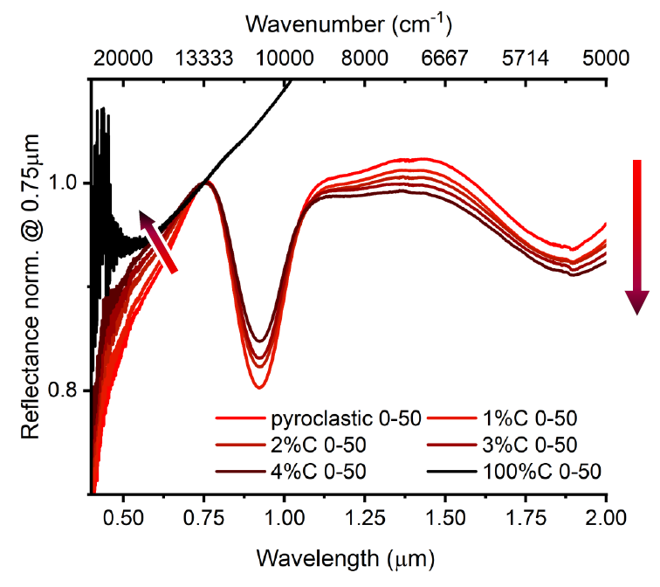
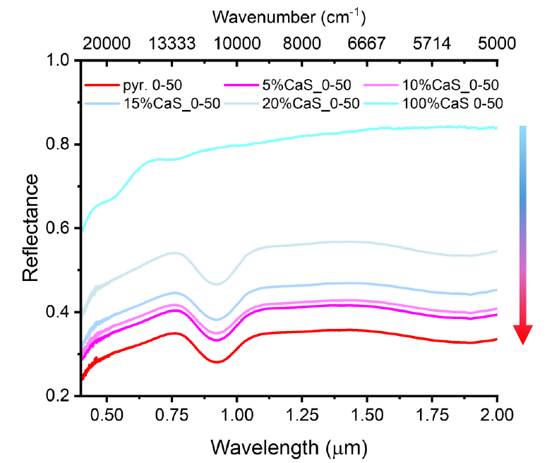
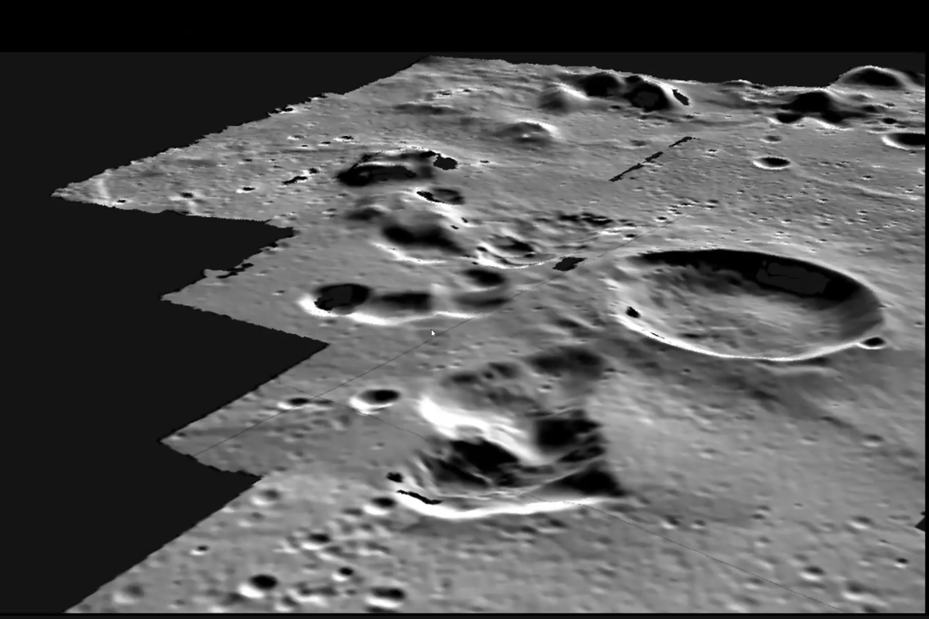
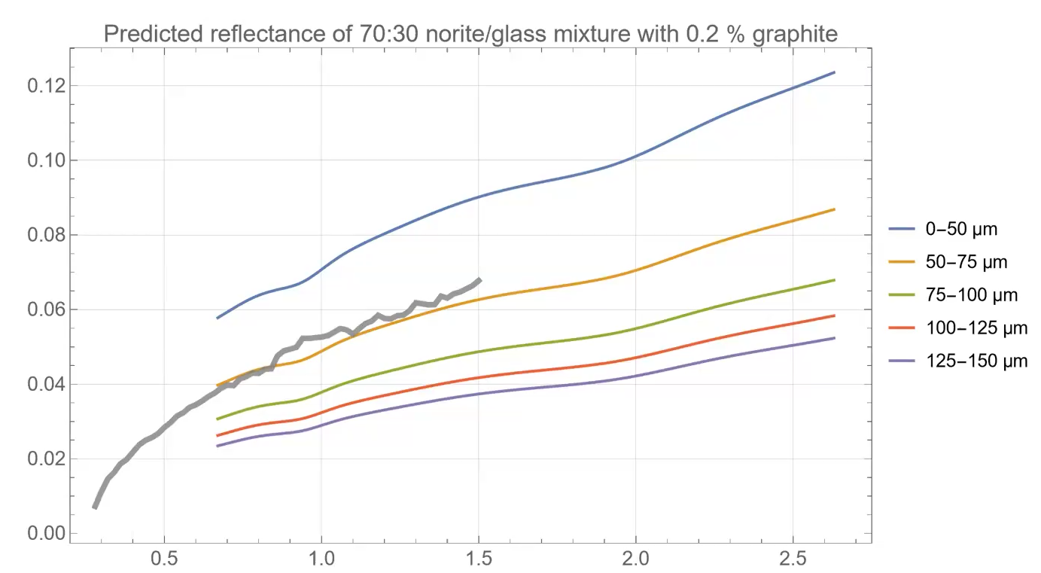
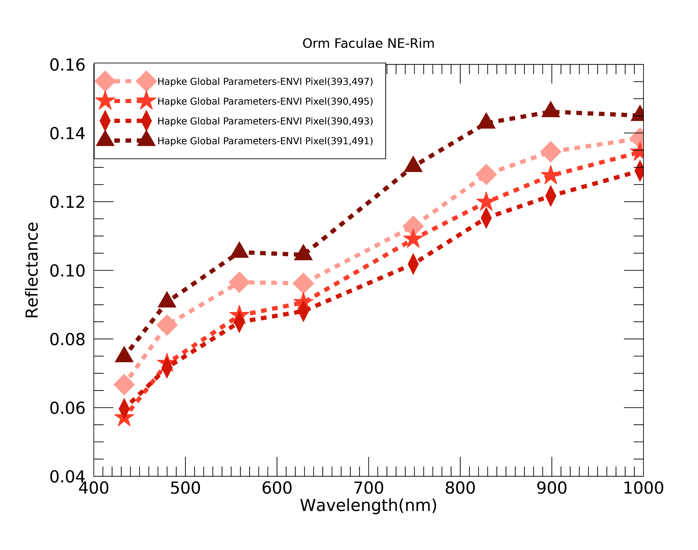
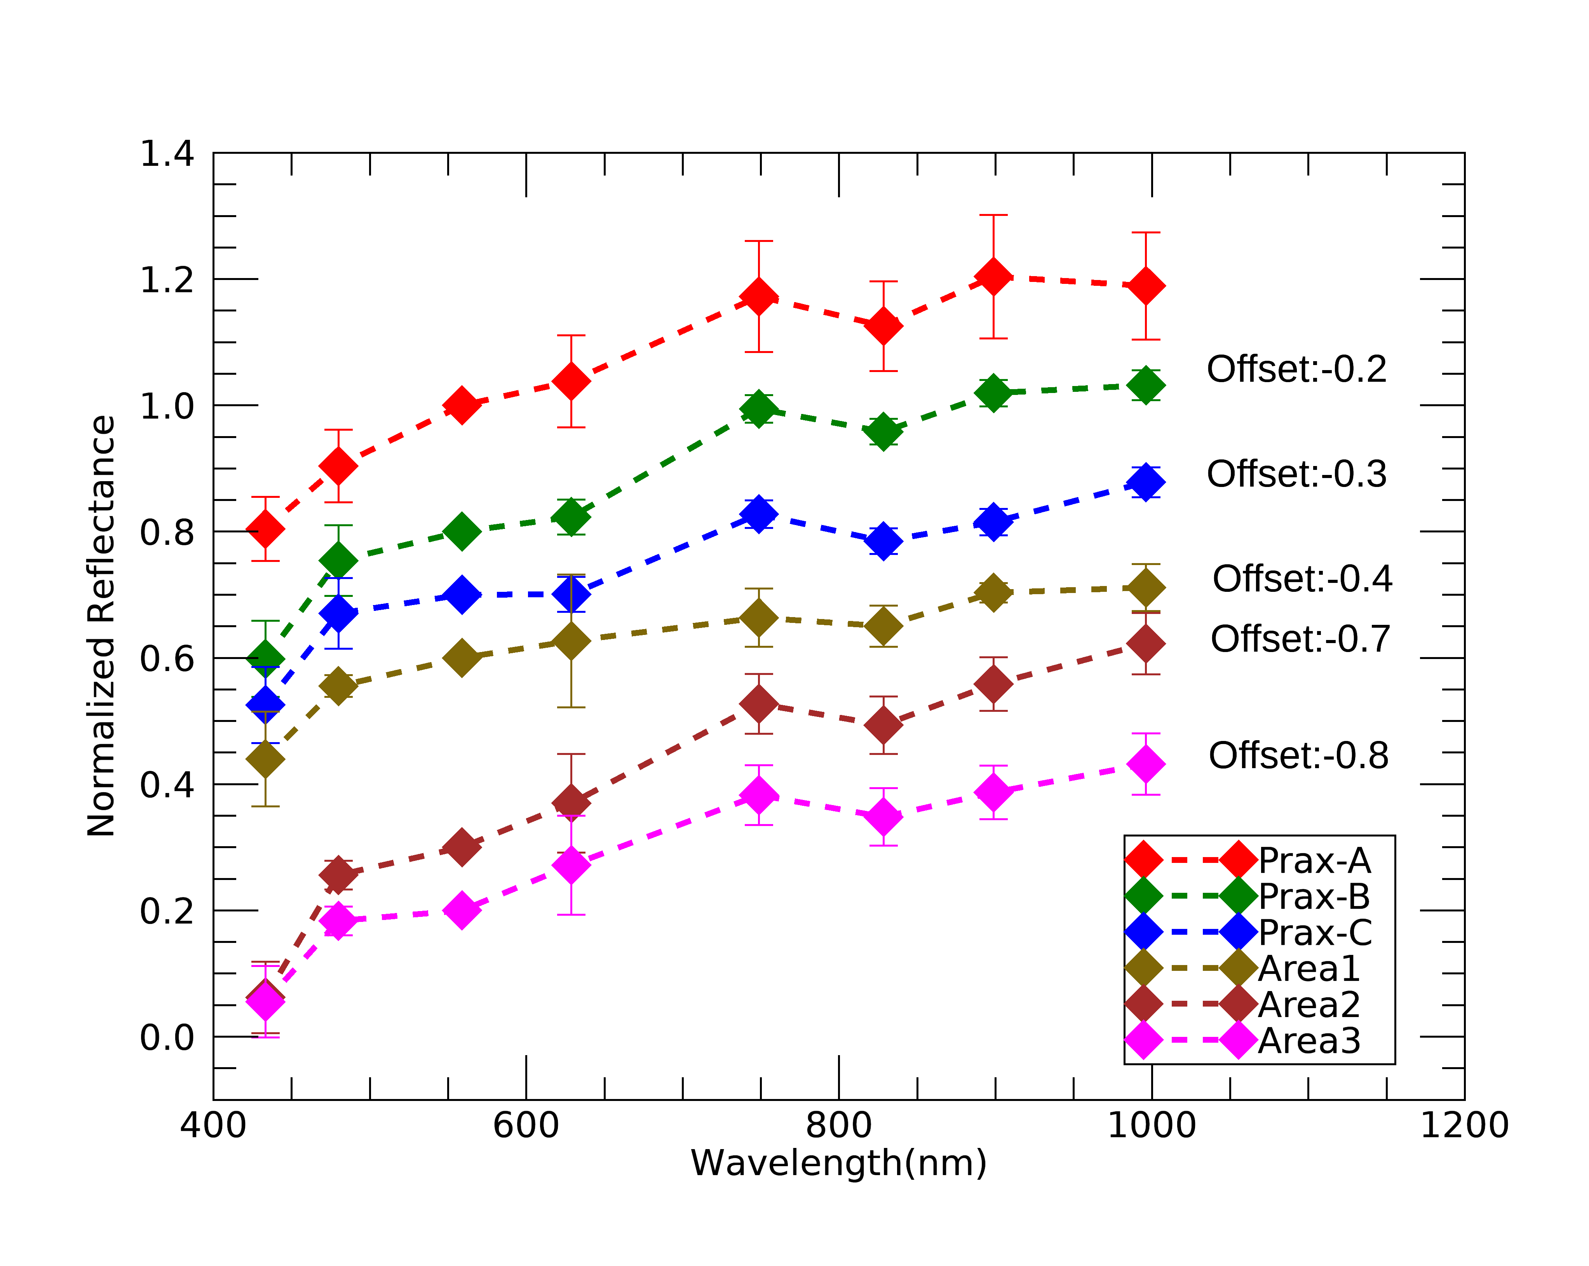
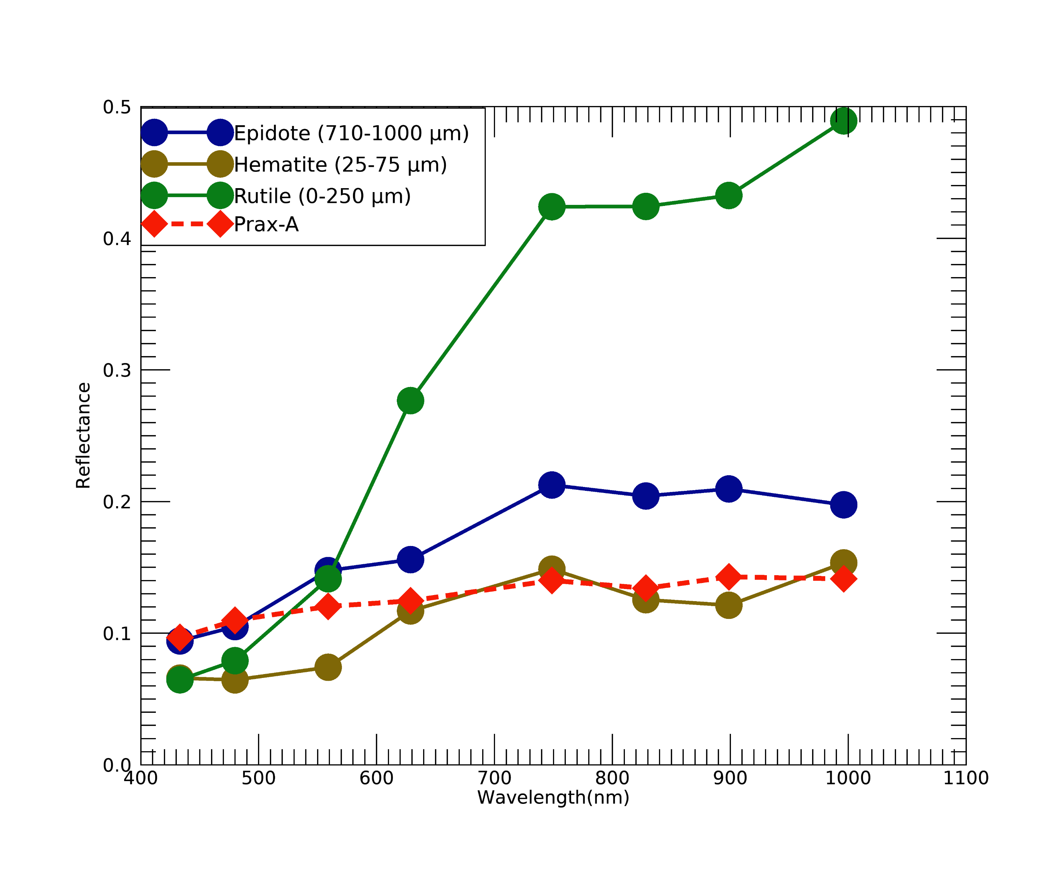
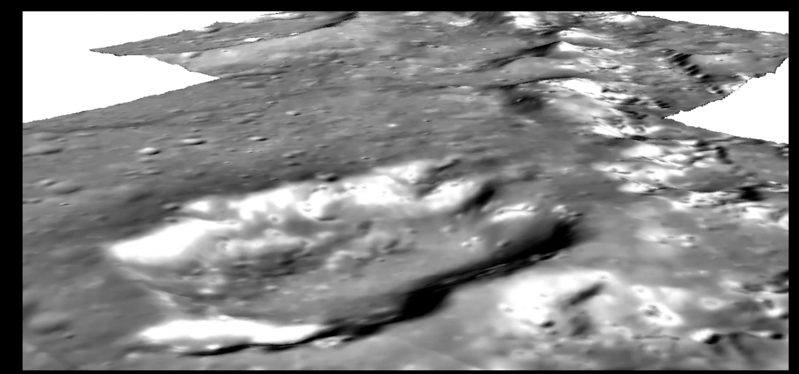
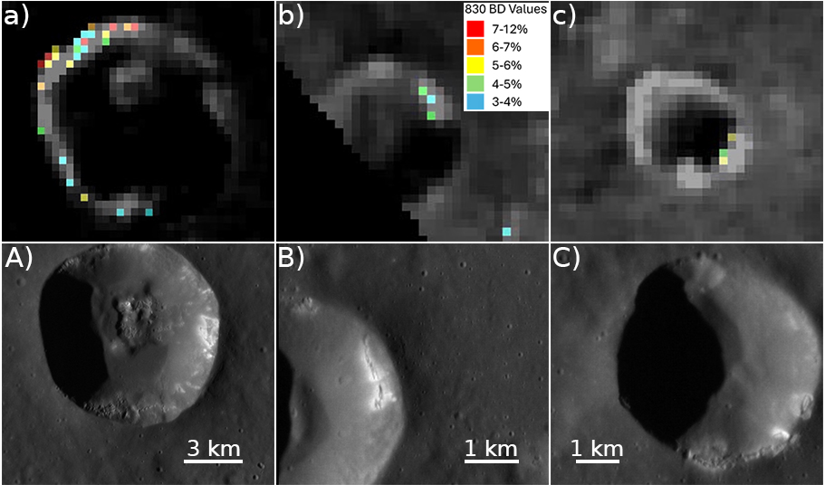
Spectral, morphological and topographical analysis of the vent
Laboratory experiment
VIS Slope (µm⁻¹)
Agwo Facula
0.15
The binary mixtures analogue of pyroclastic deposits are made of:
mafic component and graphite (C:1%,2%,3%,4%,5%,10%);
mafic component and sulphide (CaS:5%,10%,15%,20%,25%,30%).
The reflectance decreases with a higher amount of graphite and increases with a higher amount of CaS.
0.12
0.10
Rothery+(2014)
0.01
Spectral modelling
Space Weathering effects on Mercury were mimicked by simulating (with Bruggeman model) the occurrence of nanophase carbon particles on norite-glass mixture with percentage of 0.05%, 0.1%, 0,2%, 0.5% to 1%. Spectra are progressively darker, redder and featureless, similar to Mercury’s ones,
The image compares the modelled spectra with MASCS spectrum of Mercury (grey spectrum).
The compound vent of the facula are made of multiple pits with different age. For Agwo Facula older to younger pits are from A to I (Rother+, 2014). A slight correlation between spectral parameters and age of the pits suggests either a vertical heterogeneity in the crustal composition (deeper layers are richer in C) or a progressive mixing with the surrounding terrain. The topography relates the spectrally dark area inside the vent of Agwo Facula (richer in C) to a depressed region and the high-resolution geological map highlights a rougher surface for younger pits.
Orm Faculae NE
Unexpected spectral feature
slumping structure, mass movement
A recently exposed hollow-like material occurs in the vent of the faculae, supported by the spectral and topographical investigation, and the high-resolution geological maps. The case of Orm faculae NE is shown, where a mass movement in the western rim of the vent probably exposed hollow-like material with a 630-nm band in MDIS spectra
An absorption feature at 830 nm was detected in freshly exposed material in the Praxiteles basin (hosting Orm Faculae), ascribed to Fe-rich minerals.

