Slide 1
Processes underlying the variation of the magnetic field spectral index in the inner solar wind
J. R. McIntyre, C. H. K. Chen

Slide 2
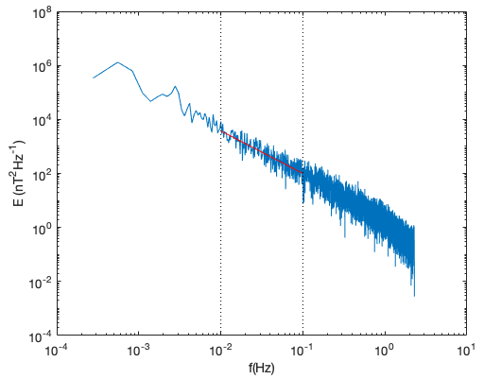

Background
Turbulence – process by which energy injected at large scales in a system is transported to small scales where it can be dissipated.
The solar wind known to contain a turbulent cascade – proposed that it plays a role in the heating and acceleration of the wind.
Important diagnostic is the spectral index.
Common predictions for the index in incompressible magnetohydrodynamic turbulence theory are -5/3 and -3/2.
-5/3 predicted by 1995 Goldreich-Sridhar anisotropic turbulence model and -3/2 predicted by 2006 Boldyrev scale-dependent alignment model
We look at the behaviour of the magnetic spectral index with distance from the Sun.
$$−1.57±0.05$$
Magnetic trace power spectral density from a one hour interval on 1st Nov 2018.

Slide 3
Data used
Parker Solar Probe encounters one to eleven.
Magnetic field data provided by the fluxgate magnetometer of the FIELDS instrument suite.
Ion velocity data and density data provided by the SPAN-I instrument of the SWEAP suite.
Density data also obtained from the quasi-thermal noise (QTN) measurements made by the Radio Frequency Spectrometer Low Frequency Receiver where available.

Slide 4
Variation of magnetic spectral index with
heliocentric distance
Previous work (Chen et al. 2020, Shi et al. 2021, Sioulas et al. 2022) found variation in the magnetic spectral index with heliocentric distance.
Far from Sun consistent with -5/3, at the smallest distances reached results are consistent with -3/2.
Clear levelling off in the spectral index as the Sun is approached.
What is the physical mechanism behind this?
Chen et al. 2020
Notes:
Test note

Slide 5
Variation of magnetic spectral index with
heliocentric distance
Previous work (Chen et al. 2020, Shi et al. 2021, Sioulas et al. 2022) found variation in the magnetic spectral index with heliocentric distance.
Far from Sun consistent with -5/3, at the smallest distances reached results are consistent with -3/2.
Clear levelling off in the spectral index as the Sun is approached.
What is the physical mechanism behind this?
Notes:
Test note

Slide 6

Variation of magnetic spectral index with
cross helicity
Normalised cross helicity, , is known to vary with heliocentric distance. Measured in the inertial range.
Index trend with cross helicity agrees with that observed by Chen et al. 2013 at 1 AU and by Sioulas et al. 2022 across a broad range of distances with PSP.

Slide 7
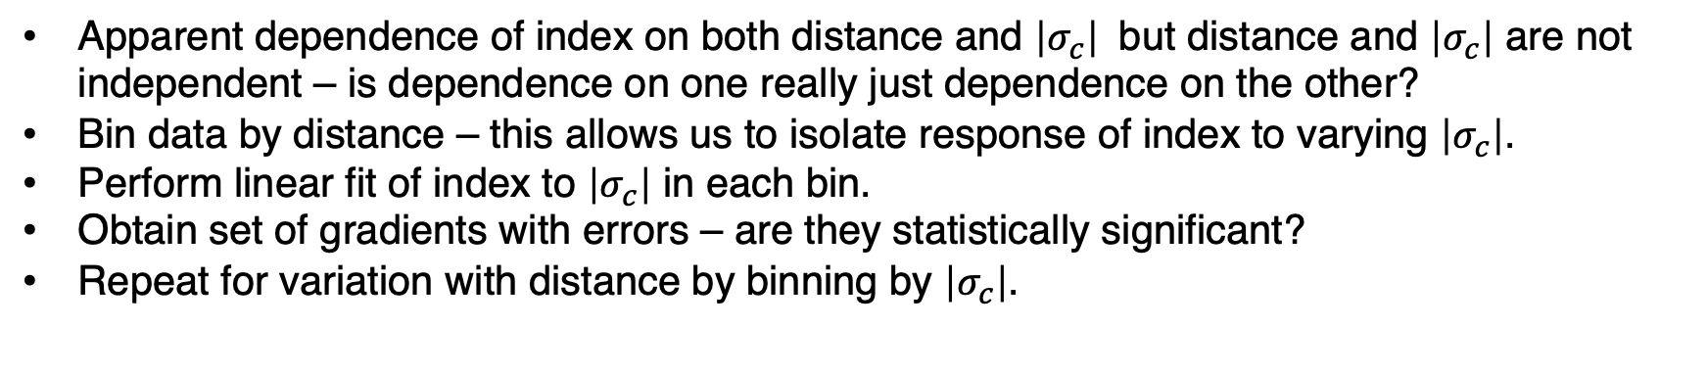
Variation of magnetic spectral index with
cross helicity
Apparent dependence of index on both distance and $\left|σ_{c}\right|$ but distance and $\left|σ_{c}\right|$ are not independent – is dependence on one really just dependence on the other?
Bin data by distance – this allows us to isolate response of index to varying $\left|σ_{c}\right|$.
Perform linear fit of index to $\left|σ_{c}\right|$ in each bin.
Obtain set of gradients with errors – are they statistically significant?
Repeat for variation with distance by binning by $\left|σ_{c}\right|$.

Slide 8
Variation of magnetic spectral index with
cross helicity
Apparent dependence of index on both distance and $\left|σ_{c}\right|$ but distance and $\left|σ_{c}\right|$ are not independent – is dependence on one really just dependence on the other?
Bin data by distance – this allows us to isolate response of index to varying $\left|σ_{c}\right|$.
Perform linear fit of index to $\left|σ_{c}\right|$ in each bin.
Obtain set of gradients with errors – are they statistically significant?
Repeat for variation with distance by binning by $\left|σ_{c}\right|$.

Slide 9
Variation of magnetic spectral index with
cross helicity
Apparent dependence of index on both distance and $\left|σ_{c}\right|$ but distance and $\left|σ_{c}\right|$ are not independent – is dependence on one really just dependence on the other?
Bin data by distance – this allows us to isolate response of index to varying $\left|σ_{c}\right|$.
Perform linear fit of index to $\left|σ_{c}\right|$ in each bin.
Obtain set of gradients with errors – are they statistically significant?
Repeat for variation with distance by binning by $\left|σ_{c}\right|$.

Slide 10
Variation of magnetic spectral index with
cross helicity
Apparent dependence of index on both distance and $\left|σ_{c}\right|$ but distance and $\left|σ_{c}\right|$ are not independent – is dependence on one really just dependence on the other?
Bin data by distance – this allows us to isolate response of index to varying $\left|σ_{c}\right|$.
Perform linear fit of index to $\left|σ_{c}\right|$ in each bin.
Obtain set of gradients with errors – are they statistically significant?
Repeat for variation with distance by binning by $\left|σ_{c}\right|$.

Slide 11
Variation of magnetic spectral index with
cross helicity
Apparent dependence of index on both distance and $\left|σ_{c}\right|$ but distance and $\left|σ_{c}\right|$ are not independent – is dependence on one really just dependence on the other?
Bin data by distance – this allows us to isolate response of index to varying $\left|σ_{c}\right|$.
Perform linear fit of index to $\left|σ_{c}\right|$ in each bin.
Obtain set of gradients with errors – are they statistically significant?
Repeat for variation with distance by binning by $\left|σ_{c}\right|$.

Slide 12
Variation of magnetic spectral index with
cross helicity
Apparent dependence of index on both distance and $\left|σ_{c}\right|$ but distance and $\left|σ_{c}\right|$ are not independent – is dependence on one really just dependence on the other?
Bin data by distance – this allows us to isolate response of index to varying $\left|σ_{c}\right|$.
Perform linear fit of index to $\left|σ_{c}\right|$ in each bin.
Obtain set of gradients with errors – are they statistically significant?
Repeat for variation with distance by binning by $\left|σ_{c}\right|$.

Slide 13
Variation of magnetic spectral index with
cross helicity
Apparent dependence of index on both distance and $\left|σ_{c}\right|$ but distance and $\left|σ_{c}\right|$ are not independent – is dependence on one really just dependence on the other?
Bin data by distance – this allows us to isolate response of index to varying $\left|σ_{c}\right|$.
Perform linear fit of index to $\left|σ_{c}\right|$ in each bin.
Obtain set of gradients with errors – are they statistically significant?
Repeat for variation with distance by binning by $\left|σ_{c}\right|$.

Slide 14


Variation of magnetic spectral index with
cross helicity
Least squares slope of $α$ vs. distance
Least squares slope of $α$ vs. $\left|σ_{c}\right|$
Data binned according to cross helicity (left) or heliocentric distance (right) and a linear fit of the index to the other variable performed within each bin.
When holding cross helicity constant (left) there is no significant trend with distance.
When holding distance constant (right) there is still a significant trend with cross helicity.

Slide 15
Variation of magnetic spectral index with
residual energy
Normalised residual energy, , is also known to vary with heliocentric distance.
Index trend with residual energy agrees with that observed by Bowen et al. 2018 at 1 AU.

Slide 16


Variation of magnetic spectral index with
residual energy
Least squares slope of $α$ vs. $\left|σ_{r}\right|$
Least squares slope of $α$ vs. $\left|σ_{c}\right|$
As before data binned by distance and a linear fit of the index to residual energy performed within each bin (left).
When holding distance constant there is still some evidence for a trend with residual energy, though not as clear as is the case for cross helicity (right).

Slide 17
Cross helicity or residual energy?
Cross helicity and residual energy do not vary independently.
Possible trend with one is just a result of the trend with the other.

Slide 18


Cross helicity or residual energy?
Least squares slope of $α$ vs. $\left|σ_{c}\right|$
Least squares slope of $α$ vs. $\left|σ_{r}\right|$
Data binned according to residual energy (left) or cross helicity (right) and a linear fit of the index to the other variable performed within each bin.
When holding residual energy constant (left) there is still a significant trend with cross helicity.
When holding cross helicity constant (right) there is no significant trend with residual energy.

Slide 19




Other parameters tested
$$\left|σ_{c}\right|$$
Velocity
Turbulence age
$$θ_{BV}$$
$${δB}^{2}/B_{0}^{2}$$
$${δB}^{2}$$

Slide 20
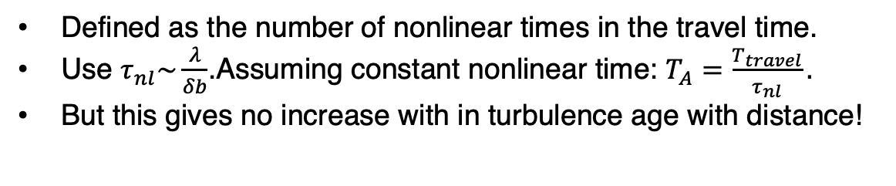
Turbulence age calculation
Defined as the number of nonlinear times in the travel time.
Use $τ_{nl}\sim \frac{λ}{δb}$.Assuming constant nonlinear time: $T_{A}=\frac{T_{travel}}{τ_{nl}}.$
But this gives no increase with in turbulence age with distance!

Slide 21
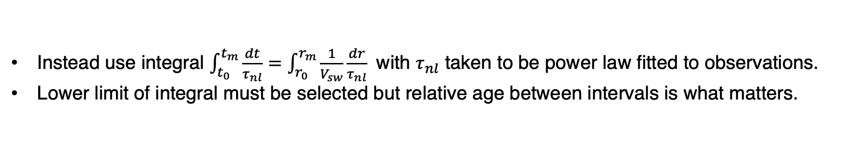
Turbulence age calculation
Instead use integral $\int_{t_{0}}^{t_{m}}{\frac{dt}{τ_{nl}}=\int_{r_{0}}^{r_{m}}{\frac{1}{V_{sw}}\frac{dr}{τ_{nl}}} }$ with $τ_{nl}$ taken to be power law fitted to observations.
Lower limit of integral must be selected but relative age between intervals is what matters.

Slide 22
Possible mechanisms
Existing imbalanced models do not account for observed behaviour.
Excess residual energy could manifest as current sheets. Li et al. 2011 found current sheets result in steeper spectra – but why is the trend with cross helicity stronger?
Possible that residual energy is maximised for a given cross helicity.
Strength of non linear terms in the Elsasser evolution equation?
Imbalanced regions are where the theorised “helicity barrier” (Meyrand et al. 2021) is thought to be active.

Slide 23
Summary
We found variation in the magnetic spectral index with distance - far from the Sun we find it to be consistent with -5/3 but it increases with decreasing radial distance to be consistent with -3/2 close to the Sun - indicating unexpected changes in the turbulence.
Cross helicity found to be the strongest candidate for the underlying parameter responsible for the transition.
Mechanism responsible is unclear, no explanation has singled out cross helicity. Potential explanation through link to residual energy or otherwise through fundamentally different nature of imbalanced turbulence.

