Slide 1
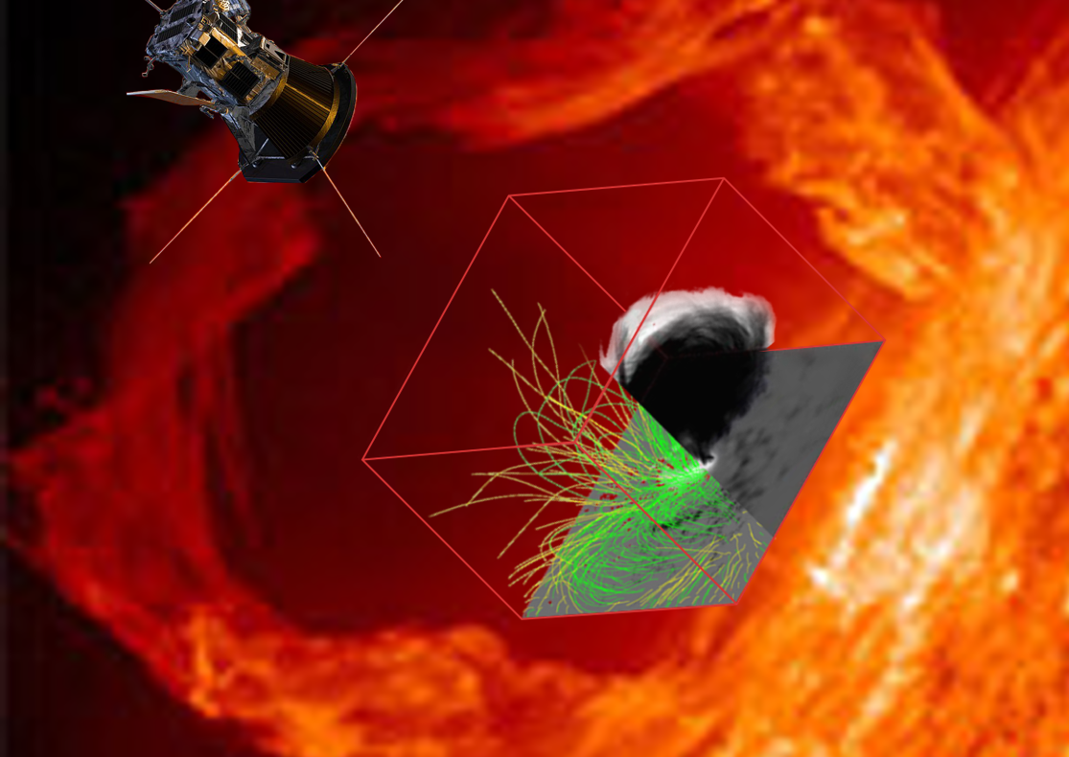
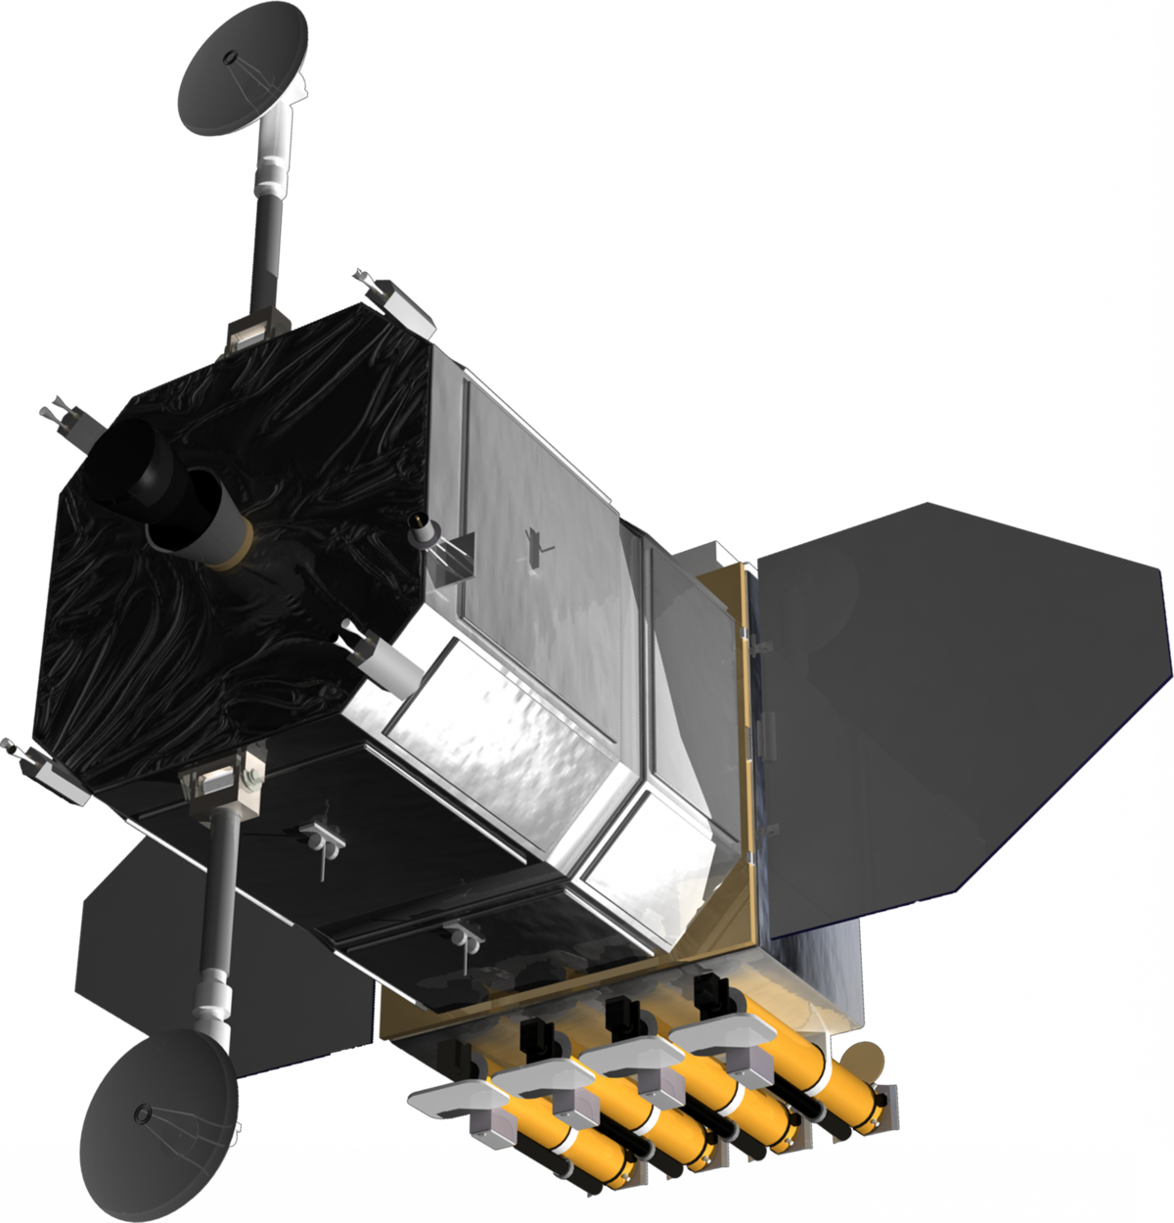
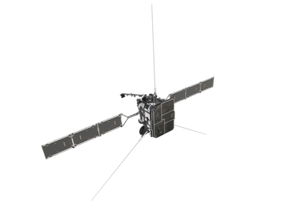
Data-constrained 3D Modeling of Solar Flares and Active Regions with GX Simulator
Gelu M. Nita, on behalf of the GX Simulator Team
Center for Solar-Terrestrial Research
New Jersey Institute of Technology

Slide 2
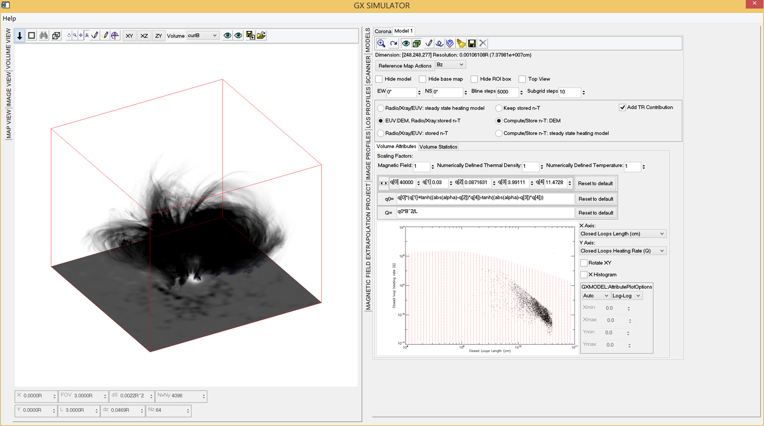
Product of a decade-long Teamwork
Eduard Kontar
X-ray Simulation
Codes
Gregory Fleishman
Alexey Kuznetsov
GS/GR Fast Codes
Maria Lukicheva
Chromospheric Models
Jim Klimchuk
Nicki Viall
Sam Schonfeld
Coronal Magneto Thermal Structures
and EUV Simulation Codes
Alexey Stupishin
Optimized NLFFF Extraplolation Codes
Dale Gary
Microwave
Imaging Spectropolarimetry
Gelu Nita
Architecture and Developement
Sergey Anfinogentov
Automated 3D Model Production Pipeline
Notes:
I would like to start this presentation by pointing out that, while I am proud to be the lead architect and developer of this package, GX Simulator is the product of more than 10 years of teamwork, which integrates theoretical insights and software modules contributed by ….and many others

Slide 3
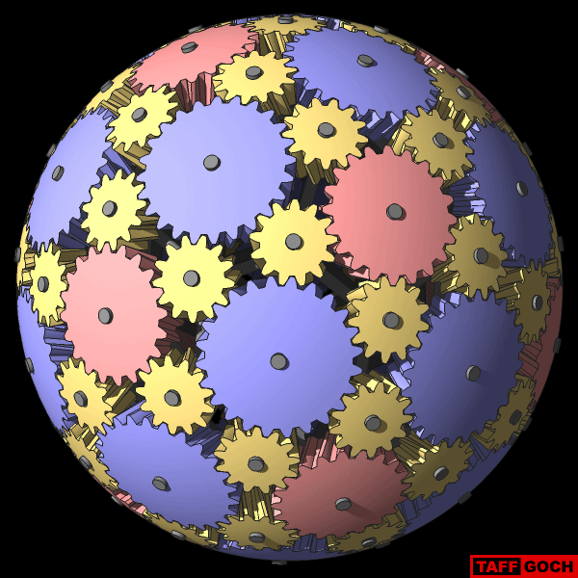
GX Simulator Framework
Puts together different observational inputs, theoretical methods, simulations and modeling, to create data-constrained modeling of a 3D volume of interest
IDL/SSW Package
https://github.com/Gelu-Nita/GX_SIMULATOR/
Nita et al. 2023, ApjS
https://doi.org/10.3847/1538-4365/acd343

Slide 4
GX SIMULATOR: Synthetic Microwave Brightness Temperature and Polarization Maps Covering the EOVSA, VLA, and ALMA Observing Ranges
Notes:
In conclusion, GX Simulator is a powerful modeling package that may be used to build and fine tune 3D models of the solar atmosphere that may be validated by generating a set of synthetic multiwavelength EUV, X-ray, and microwave maps covering the AIA, RHESSI, EOVSA, VLA and ALMA observing ranges. Thank you for your attention, and I that hope you enjoyed this presentation.

Slide 5
Automatic GX Model Production Pipeline (AMPP) Nita et al. 2023, https://arxiv.org/abs/2301.00795, ApJS in press
Selection of time, position and spatial resolution of the model
Initial potential field extrapolation
NLFFF optimization
(Windows, Unix/MAC)
Automatic download of SDO HMI/AIA data
closest to the time requested
Computation of the length and averaged magnetic field for all voxels crossed by closed magnetic field lines, to be used by GX Simulator to assign parametrized differential emission measure and density and temperature distribution models of the corona
WCS coordinate transformation of HMI data to create the base of the subsequent extrapolations
Creation of an empty-box structure containing a WCS-compatible index, LOS Bz, Ic, and the requested AIA UV/EUV reference maps
Adding non-LTE density and temperature distribution models of the chromosphere
Notes:
Another key component of the GX Simulator package is the Automatic GX Model Production Pipeline, which is a collection of scripts capable of producing GX Simulator compatible models based on a set of minimal input parameters provided by the user, to indicate the date, time, and desired size and resolution of the model. Based on these parameters, the pipeline downloads from the SDO repository all needed input maps and performs all necessary geometrical transformation to build the model box and place it in the correct location.
An essential component of the pipeline is a very fast nonlinear force free field extrapolation module that now is available on Windows and Unix/Mac platforms.
However, the modular the architecture of the pipeline allows integrations of user-provided extrapolation codes.
The next block of the pipeline computes the magnetic field lines crossing each voxel in the volume and records their lengths and average magnetic field, which may be used to assign a parameterized user-adjustable EBTEL model to the coronal part of the model
Finally, based on the line-of-sight magnetic field and white-light HMI maps, a non-LTE density and temperature model of the chromosphere is computed and added to the model

Slide 6
AMPP Script and GUI
;Documentation:
;\ssw\packages\gx_simulator\util\Step-by-step instructions for creating GX Simulator models.html
time='2017-09-04 20:34:42’ ;time to search for SDO data
center_arcsec=[250,-250] ;center pixel in arcseconds
size_pix=[160,120,120] ;box size in voxels
dx_km=1000 ;resolution in kilometers
tmp_dir='C:\jsoc_cache’ ;local data input repository
out_dir='C:\gx_models' ;local model output repository
;calling sequence of the top level AMPP procedure
gx_fov2box, time, center_arcsec=center_arcsec, size_pix=size_pix, dx_km=dx_km, out_dir=out_dir,tmp_dir=tmp_dir, /cea, /euv, /uv ,/nlfff_only
;IDL console output
% GX_FOV2BOX: Data not found in the local repository, downloaded in 146.127 seconds
% GX_FOV2BOX: Creating the box structure
% GX_FOV2BOX: Box structure created in 17.315 seconds
% GX_FOV2BOX: Performing initial potential extrapolation
% GX_FOV2BOX: Potential extrapolation performed in 2.928 seconds
% GX_FOV2BOX: Potential box structure saved to
C:\gx_models\2017-09-04\hmi.M_720s.20170904_202242.W119S8CR.CEA.POT.sav
% GX_FOV2BOX: Performing NLFFF extrapolation
% GX_FOV2BOX: NLFFF extrapolation performed in 252.11 seconds
% GX_FOV2BOX: NLFFF box structure saved to
C:\gx_models\2017-09-04\hmi.M_720s.20170904_202242.W119S8CR.CEA.NAS.sav

Slide 7
GX Simulator Model Produced by AMPP
Earth LOS
Solar Local Normal

Slide 8
Use HMI vector magnetic field measurements to generate a 3D NLFFF magnetic field model and compare its topology with available Earth-LOS multiwavelength data

Slide 9
GX Workflow: Magneto-Thermal Coronal Models
Uses measured boundary conditions to compute the magnetic field model
Assigns parametrized heating rates along each individual field line
Assigns precomputed field-aligned hydrodynamic models
Fast NLFFF extrapolation codes (Fleishman et al. 2017), which employ a modified version of the weighted optimization algorithm (Wiegelmann 2004).
$\left\langle Q\right\rangle =Q_{0}{\left\langle B\right\rangle }^{a}/L^{b}$ (Mandrini et al 2020)
$\left\langle B\right\rangle$- averaged magnetic field along a closed magnetic field line
$L$- length of the magnetic field line
${\{Q}_{0}, a, b\}$ –adjustable free parameters of the coronal heating model
Enthalpy-Based Thermal Evolution of Loops (EBTEL; Klimchuk et al. 2008)
Assign Differential Emission Measure (DEM )and Differential Density Measure (DDM) distributions to each volume element (voxel)
Assign {n-T} pairs to each voxel, computed as moments of the DDM or DEM distributions

Slide 10
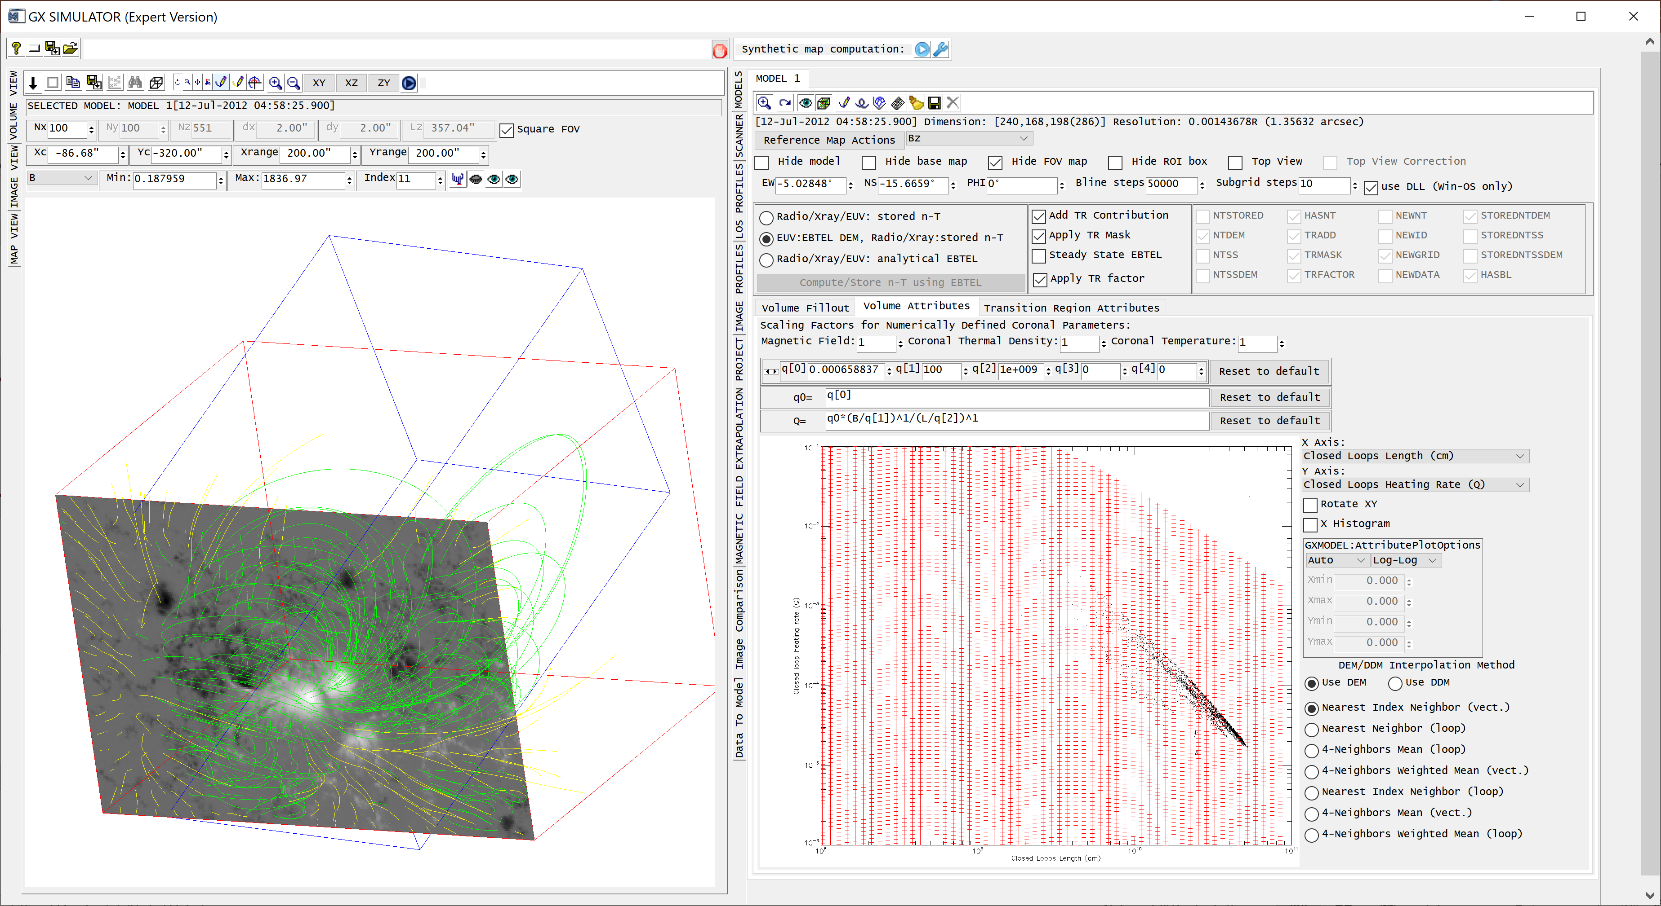
GX Simulator: Magneto-Thermal Model GUI
Notes:
The GX Simulator graphical user interface provides a series of user adjustable input fields that may be used to define volume dependent heating parameters.
Then, using a set of precomputed EBTEL solution tables, which are interpolated, appropriate differential emission measure distributions are assigned to each volume voxel.

Slide 11
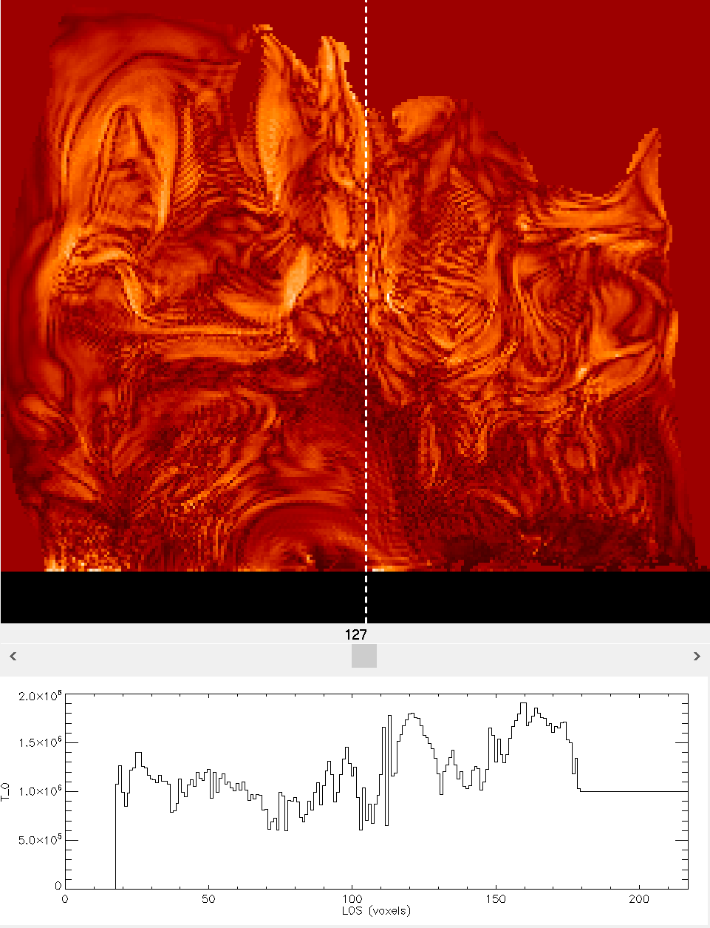
Density and Temperature 3D Distributions Derived from DEM or DDM Moments
Differential Emission Measure
Differential Density Measure
$$ξ\left(T\right)=\frac{n_{e}^{2}\left(T\right)dV}{VdT}$$
$$ν\left(T\right)=\frac{n_{e}\left(T\right)dV}{VdT}$$
$$\begin{matrix}n_{ξ}=\sqrt{\int{ξ\left(T\right)dT}} \\ or \\ n_{ν}=\int{ν\left(T\right)dT}\end{matrix}$$
$$\begin{matrix}T_{ξ}=\frac{\int{ξ\left(T\right)TdT}}{n_{ξ}} \\ or \\ T_{ν}=\frac{\int{ν\left(T\right)TdT}}{n_{ν}}\end{matrix}$$
Chromosphere Model?
1-D non-LTE
data-constrained chromosphere models
(Fontenla et al. 2009).
Coronal Density Distribution Slice
Coronal Temperature Distribution Slice

Slide 12
Corona and Chromosphere Density and Temperature 3D Distributions
$$\begin{matrix}n_{ξ}=\sqrt{\int{ξ\left(T\right)dT}} \\ or \\ n_{ν}=\int{ν\left(T\right)dT}\end{matrix}$$
$$\begin{matrix}T_{ξ}=\frac{\int{ξ\left(T\right)TdT}}{n_{ξ}} \\ or \\ T_{ν}=\frac{\int{ν\left(T\right)TdT}}{n_{ν}}\end{matrix}$$
1D non-LTE
data-constrained chromosphere models
(Fontenla et al. 2009).
Coronal Density Distribution Slice
Coronal Temperature Distribution Slice

Slide 13
Radiation Transfer Codes for Computing AR Microwave Emission
Microwave Fast codes (Fleishman & Kuznetsov, 2010, 2014, 2021)
Gyroresonance and free-free emission mechanisms from {n-T} distributions
Mode coupling in the quasi-transverse layers
Effect of limiting polarization (only circular polarization survives in corona)
NEW: Microwave Fast Codes for multicomponent multi-thermal coronal plasma (Fleishman, Kuznetsov & Landi, 2021)
Chemical composition of the plasma
Temperature-dependent ionization states of various elements (He--Zn)
Exact Gaunt factors
Free-free emission due to collisions of thermal electrons with neutral Hydrogen and Helium, and the effect of magnetic field.
Permits plasma to be directly described by DEM/DDM array-defined distributions
NEW(2021): Work with both analytically and array-defined distribution functions of non-thermal electrons

Slide 14
Modeling AR11520 Microwave Emission “Coronal Heating Law Constrained by Microwave Gyroresonant Emission” Fleishman, Anfinogentov, Stupishin, Kuznetsov & Nita 2021-ApJ
Model Temperature
Synthetic Microwave Brightness Temperature
Model Density
Notes:
Here is an example of using GX Simulator to constrain an AR coronal model by microwave observations.
The left side animation illustrates the temperature and plasma density distributions modeled with GX Simulator using an Enthalpy-Based Thermal Evolution of Loops parametrization
The right-side animation shows a set of synthetic brightness temperature maps produced from this 3D model

Slide 15
Recent GX Upgrade: Built-in Data to Model Image Comparison Tools AR11520 Data to GX Model Comparison @17GHz (Fleishman, Anfinogentov, Stupishin, Kuznetsov & Nita 2021, ApJ)
Notes:
A recent upgrade implemented a set of model to data comparison tools that allow image and spectral comparisons.
The left side map shows a 17 GHz synthetic image and the corresponding model and data contours that demonstrate an almost perfect visual agreement.
The right map shows a model to data relative residual map that demonstrates a close to unity correlation coefficient and close to zero normalized residuals.
This analysis demonstrates the ability of the GX Simulator modeling framework to fine tune the 3D active region models to observations.

Slide 16
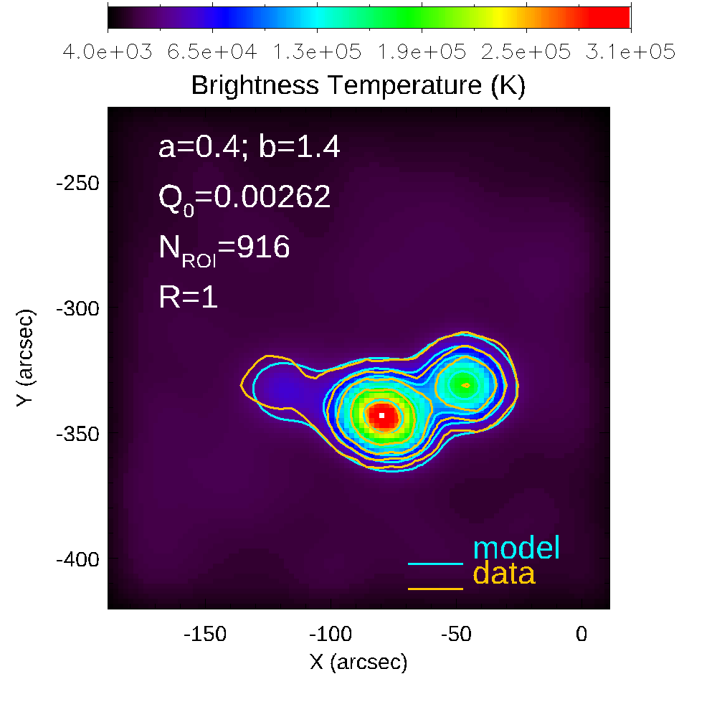
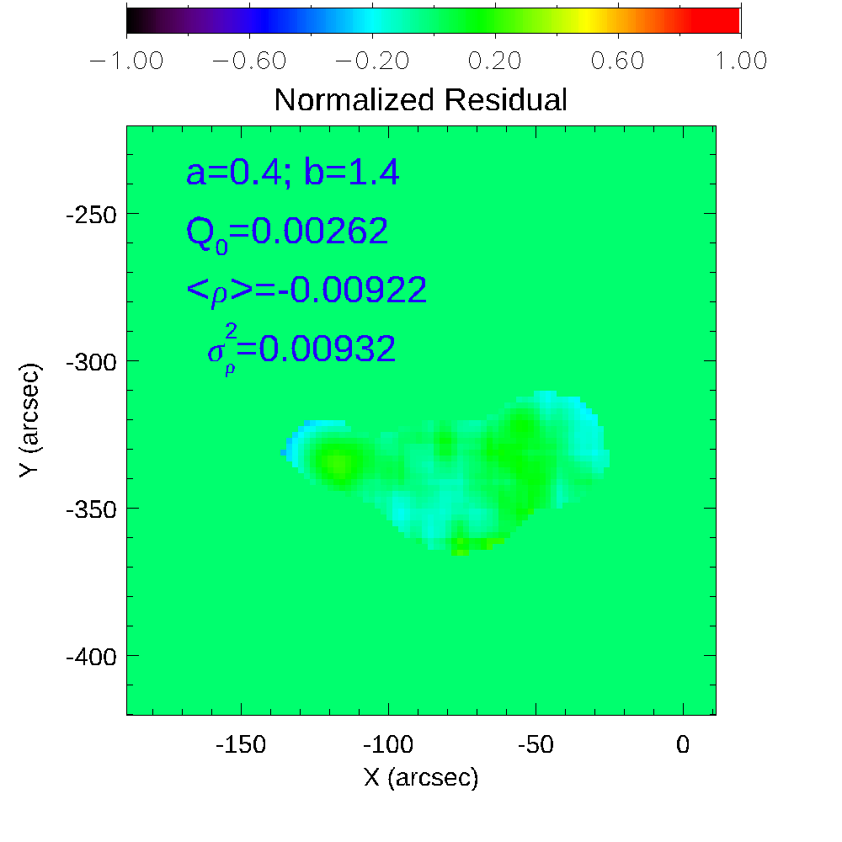
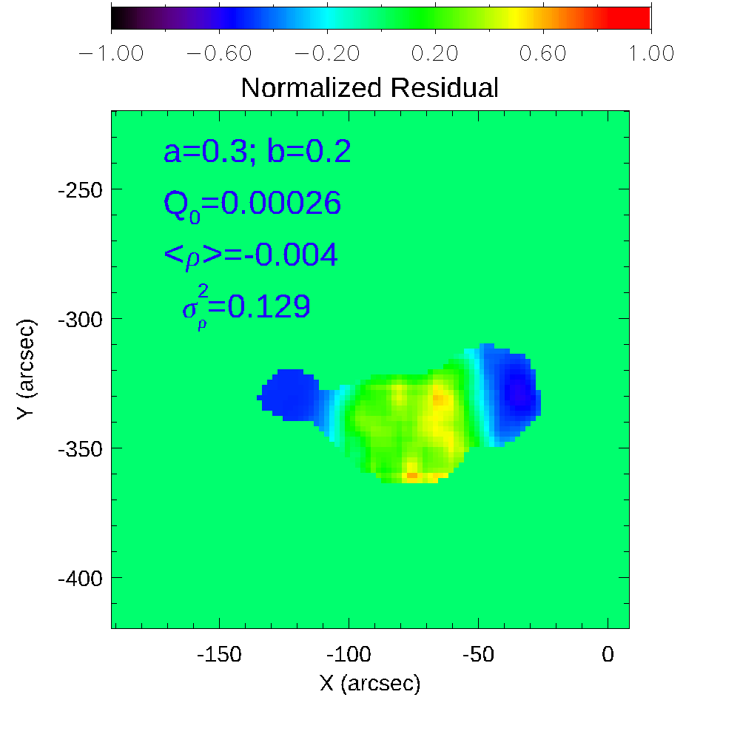
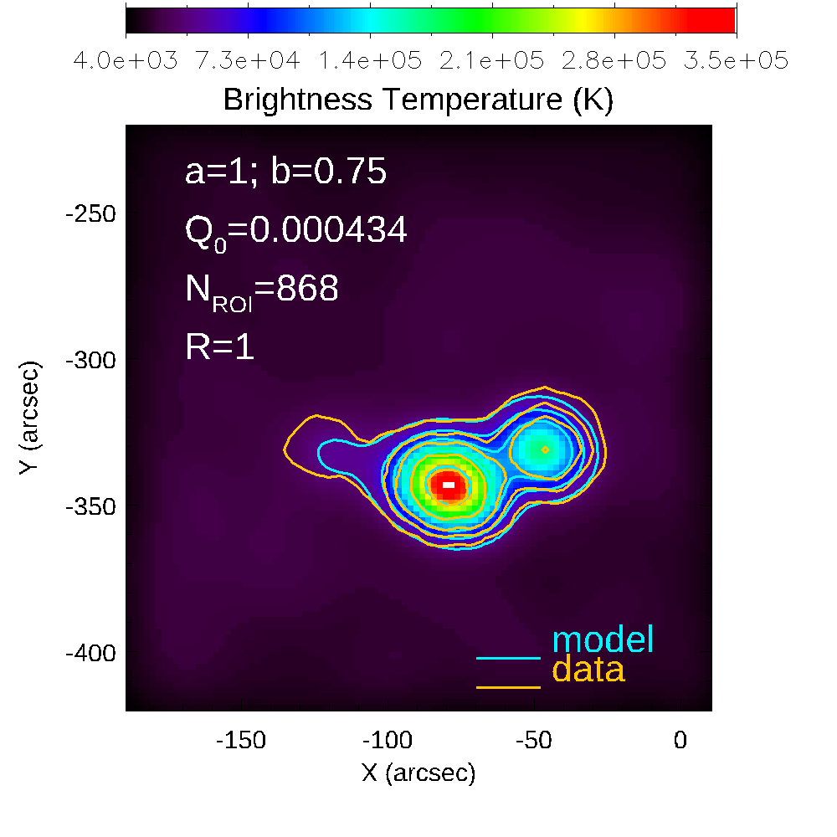
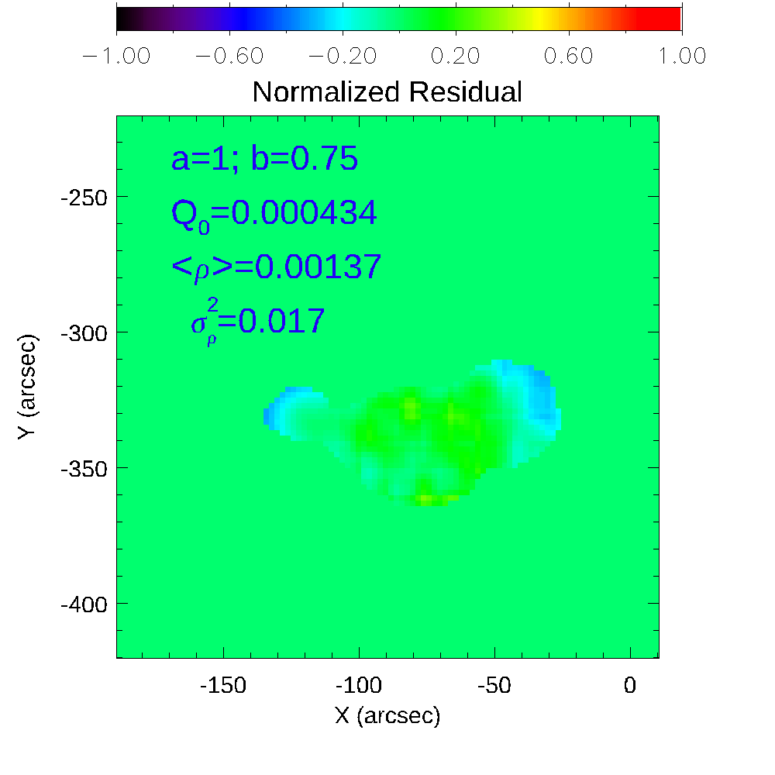
GX Model to Data Comparison Metrics
$$\left\{a,b\right\}$$
$${\left\{Q_{0}\right\}\underset{→}{\text{Model} \text{Image}}m}_{ij}$$
$$\left\langle ρ\right\rangle =\frac{1}{N}\sum_{ROI}{\frac{\left(m_{ij}⨂d_{PFS}\right)−d_{ij}}{d_{ij}}}$$
MW: Fleishman et al. (2021)
EUV: Ugarte-Urra et al. (2019)
New, Better $σ_{ρ}^{2}$ Metrics
Automatic Parameter Search
$\left|\left\langle ρ\right\rangle \right|<ε$ ?
$$\left\langle ρ^{2}\right\rangle =\frac{1}{N}\sum_{ROI}{{\left[\frac{\left(m_{ij}⨂d_{PFS}\right)−d_{ij}}{d_{ij}}\right]}^{2}}$$
$σ_{ρ}^{2}$= $\left\langle ρ^{2}\right\rangle −{\left\langle ρ\right\rangle }^{2}$
$$\underset{→}{\text{Min}\left\{σ_{ρ}^{2}\right\}}\left\{Q_{0},a,b\right\}$$
MW: Fleishman et al. (2021)
Trial and Error

Slide 17
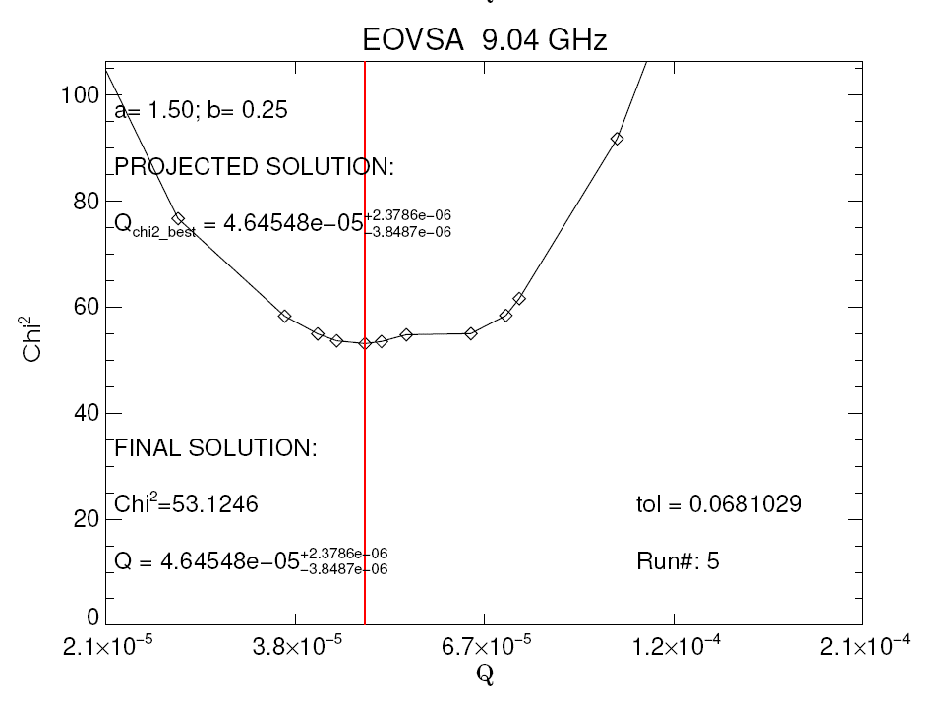
GX Automated Coronal Heating Modeling Framework
Automated Coronal Heating Modeling Pipeline (CHMP)
Automated Model Production Pipeline (AMPP)
$$\left\{Q_{0},ρ\right\}$$
{𝑄_0,𝜌}
$$σ_{ρ}^{2}$$
𝜎_𝜌^2
$$\left\{a,b\right\}$$
{𝑎,𝑏}
Data Request
Extrapolation
$\left\{\left\langle B\right\rangle , L\right\}$ Computation
Adaptive
$Q_{0}$ step
Data Validated EBTEL Coronal Heating Model

Slide 20
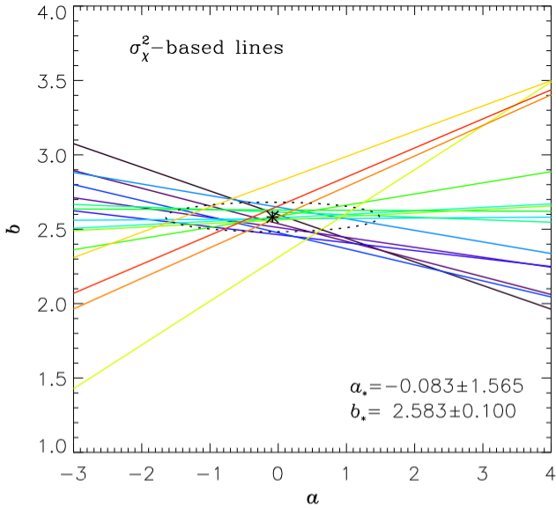
Best Coronal Heating Model(s)
Best model parameters
Best parameter region found for AR 12924 by performing multi-frequency search involving SRH observations at 16 frequencies.
Credits: Alexey Kuznetsov
AR 12924.
Could this {a,b} degeneracy be removed?
Fleishman et al. 2021
Fleishman et al. 2021
Fleishman et al. 2021
We are currently exploring such possibility by constraining the coronal heating models using multifrequency AR images, now routinely available from EOVSA and SRH, combined with other contextual multi-wavelength data that are used for validation

Slide 22
NEW: Gyrolayers Visualization in GX Simulator (gx_display_manager.pro)

Slide 23
EOVSA GYROHARMONICS OPACITY REGIONS

Slide 24
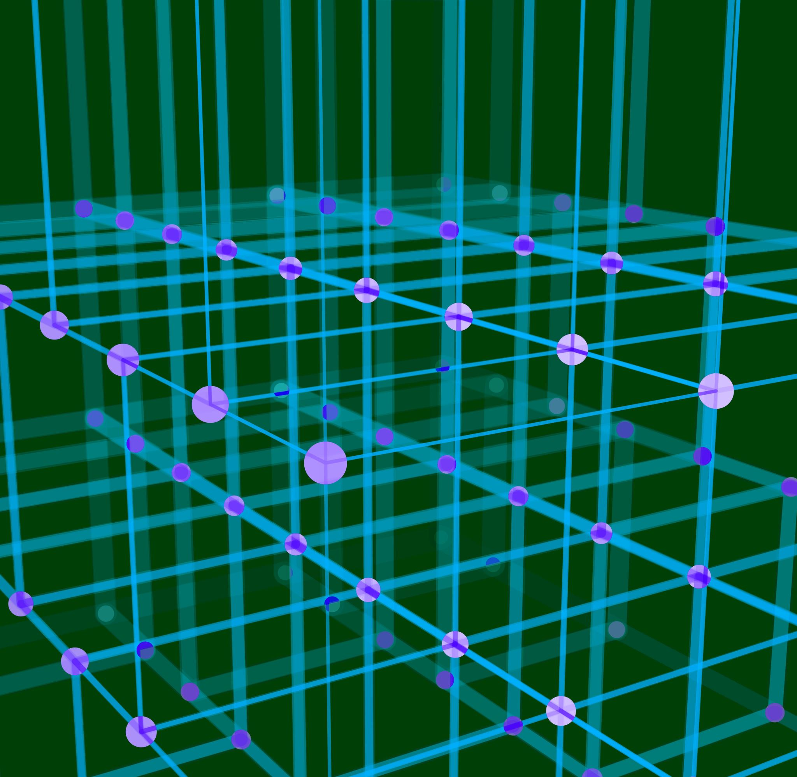
Flaring Loops Modeling with GX Simulator
In this talk I will only provide a few highlights related to flaring loops modeling with GX Simulator.
For a more detailed presentation on this subject please plan to attend Gregory Fleishman’s presentation on Thursday, WG2+ (A154) :
- Data-constrained 3D modeling of a solar flare evolution: acceleration, transport, heating, and energy budget

Slide 25
Flaring Loops Modeling with GX Simulator Nita, Fleishman, Kuznetsov, Kontar, & Gary 2015, ApJ 799, 236
Notes:
The GX Simulator flaring loop modeling framework has been originally described in Nita et al. 2015. However, since then, many upgrades have been implemented, and a series of case studies involving flare modeling have been published by us or other users of the tool.

Slide 26
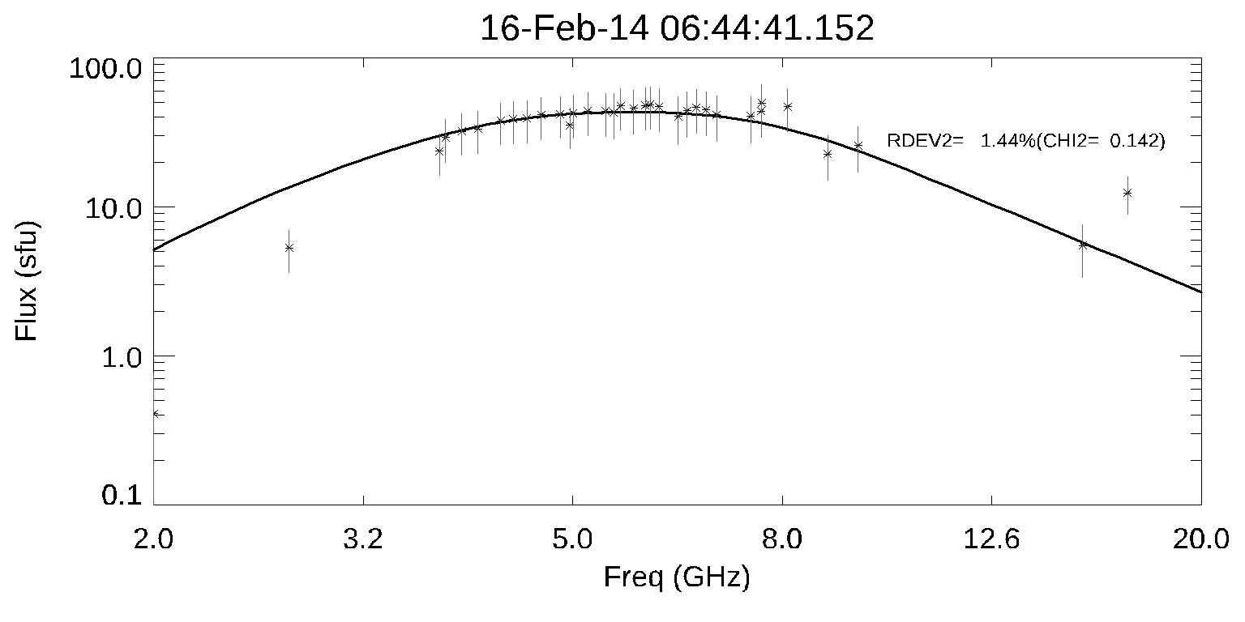
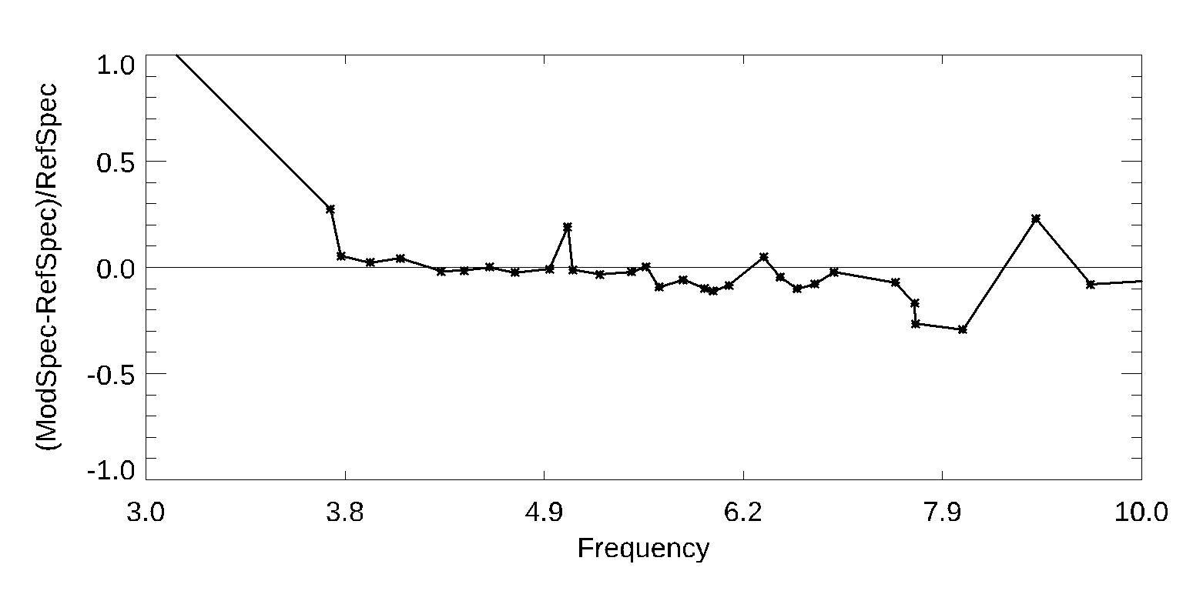
Modeling the peak of the SOL2014-02-16T064620 flare Fleishman et al. 2021 ApJ
Notes:
The ability of GX Simulator to successfully forward fit 3D flaring loop models to available observations has been already demonstrated in several published studies.
This slide illustrates a 3D model of a flare that required three loops in order to match all available multiwavelength observations.
On the left: Plasma Temperature, Thermal and Nonthermal Electron Density distributions.
The middle panel shows the multi-frequency synthetic maps produced from this model
The right panel demonstrates the successful reproduction of the observed FOV-integrated microwave spectrum

Slide 27
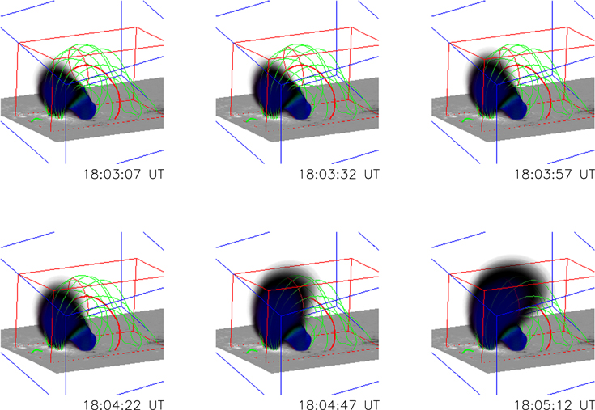
Revealing the Evolution of Non-thermal Electrons in Solar Flares Using 3D Modeling Fleishman et al 2018 ApJ 859 17
SOL2015-06-22T17:50 flare. The evolution of the number density of the non-thermal electron distributions

Slide 28
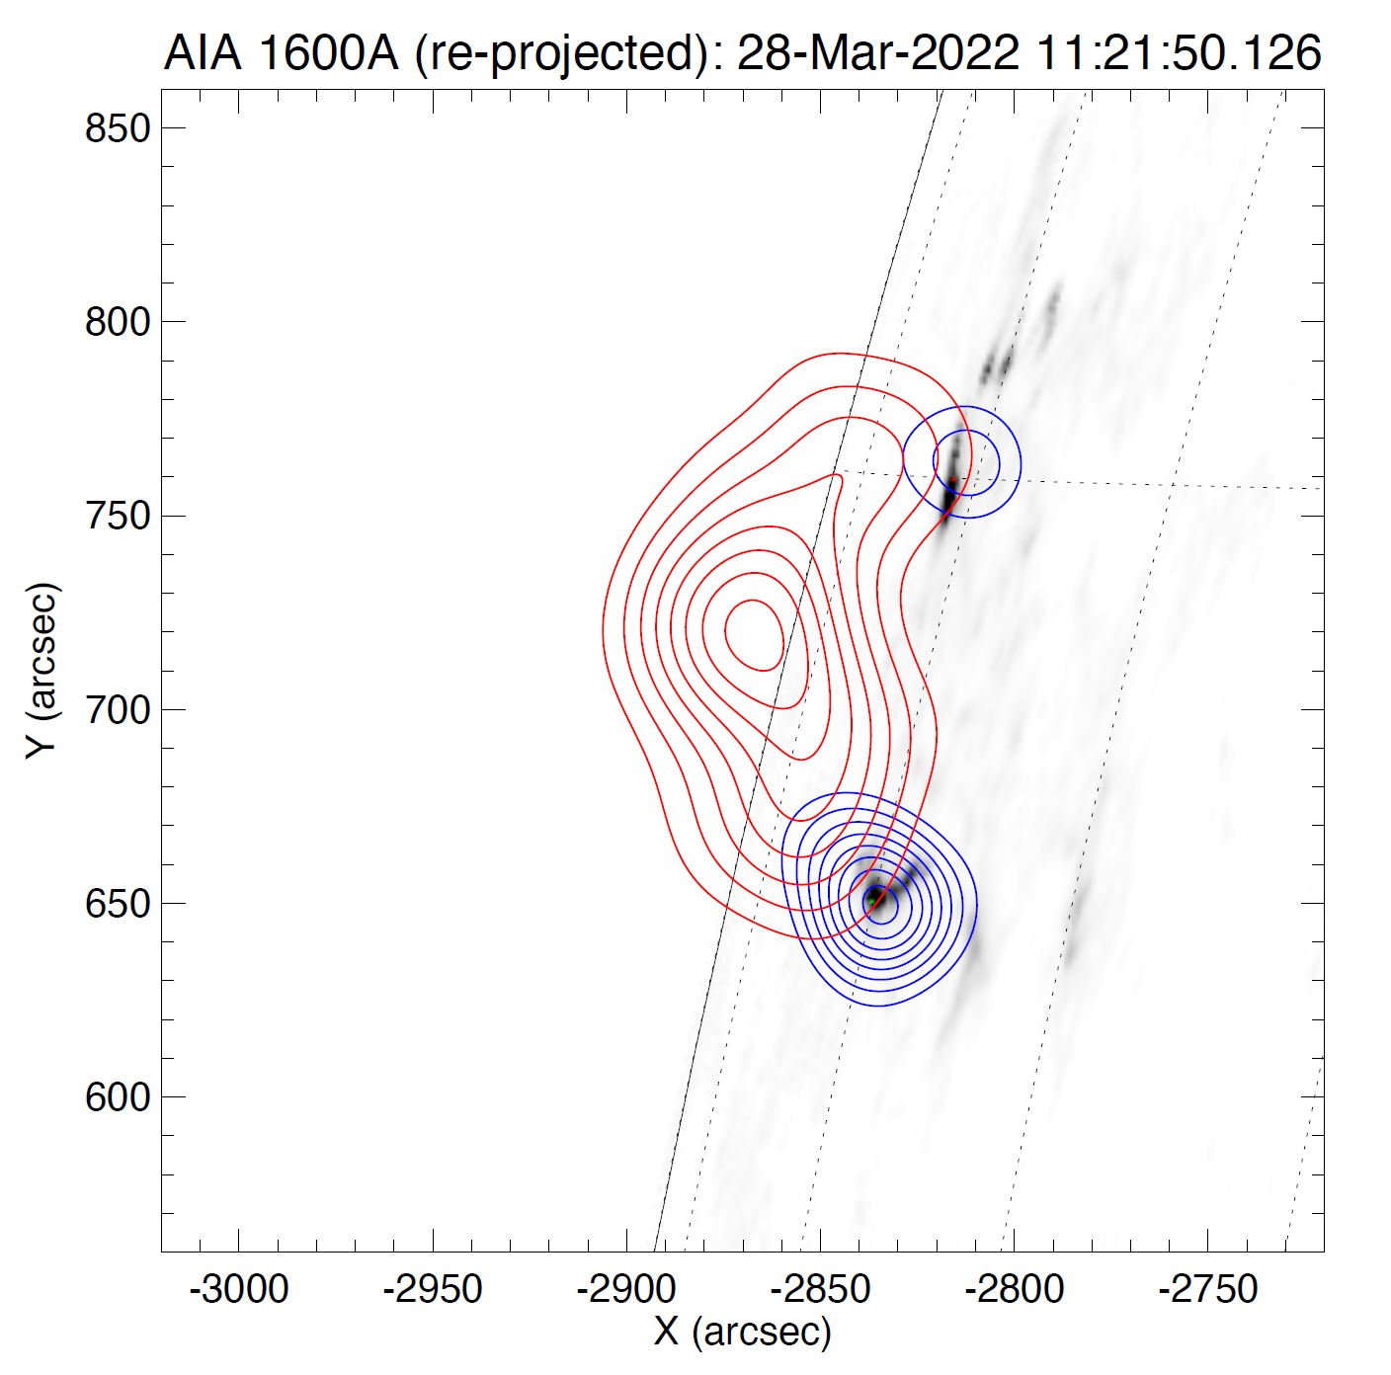
New GX Simulator Feature Ability to rotate the 3D model to any spacecraft LOS direction( e.g., Solar Orbiter) and compare it with available multiwavelength data obtained from that view. Thus, the users may use this functionality to identify a magnetic field line that may serve as the axis of a flaring fluxtube to be modeled with GX Simulator and generate multi-wavelength synthetic maps from stereoscopic standpoints.
Credits: Säm Krucker and Andrea Battaglia

Slide 29
Concluding Remarks
GX Simulator is now mature enough to address various modeling needs in both flare and AR science.
It offers convenient automatic ways to build 3D models, fine tune them, generate synthetic observables, perform data-to-model comparison, and, eventually produce 3D models compatible with all available observational constraints.
Nevertheless, to expand its functionality as needed to address various science aspects increasingly demanding more sophisticated modeling approaches, incremental upgrades are released as they become available.
A series of major upgrades is planned for the near future, which will be appropriately publicized as they become available.
In addition, to address the need for increased computational efficiency, to improve its OS platform independence, and to potentially increase its user base by becoming less dependent on the proprietary nature of the IDL programming language, a gradual transition of the GX Simulator software infrastructure to modern, more widely used, open-source languages, such as Python, as well as Jupiter notebook integration is being considered over the long term by the development team.

